Slide 1
CS4102 Algorithms Spring 2022
Warm up
Given any 5 points on the unit square, show there’s always a pair distance $≤\frac{\sqrt{2}}{2}$ apart
1
1

Slide 2
CS4102 Algorithms Spring 2022
$$\frac{1}{2}$$
If points $p_{1},p_{2}$ in same quadrant, then $δ\left(p_{1},p_{2}\right)≤\frac{\sqrt{2}}{2}$
$$\frac{\sqrt{2}}{2}$$
Given 5 points, two must share the same quadrant
1
$$\frac{1}{2}$$
Pigeonhole Principle!
1

Slide 3
At a local grocery store, early in the Covid-19 pandemic
The pigeonhole principle enforcing social distancing?!

Slide 4
Announcements
This slide set:
Closest-pair of points, Strassen’s Matrix Multiplication
Homework questions, updates
Other questions?

Slide 5
Robbie’s Yard

Slide 6
Robbie’s Yard

Slide 7
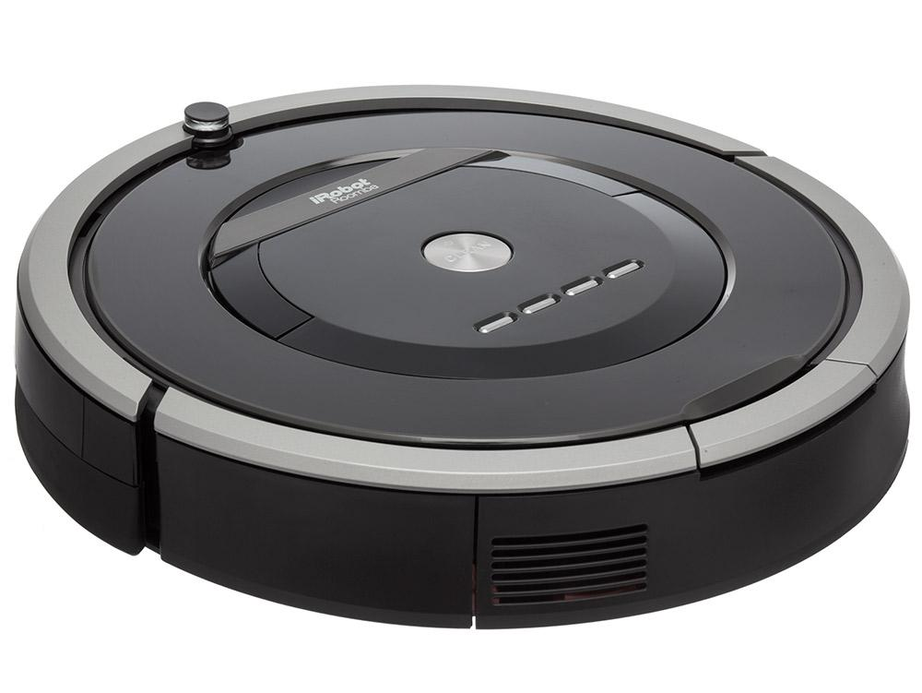
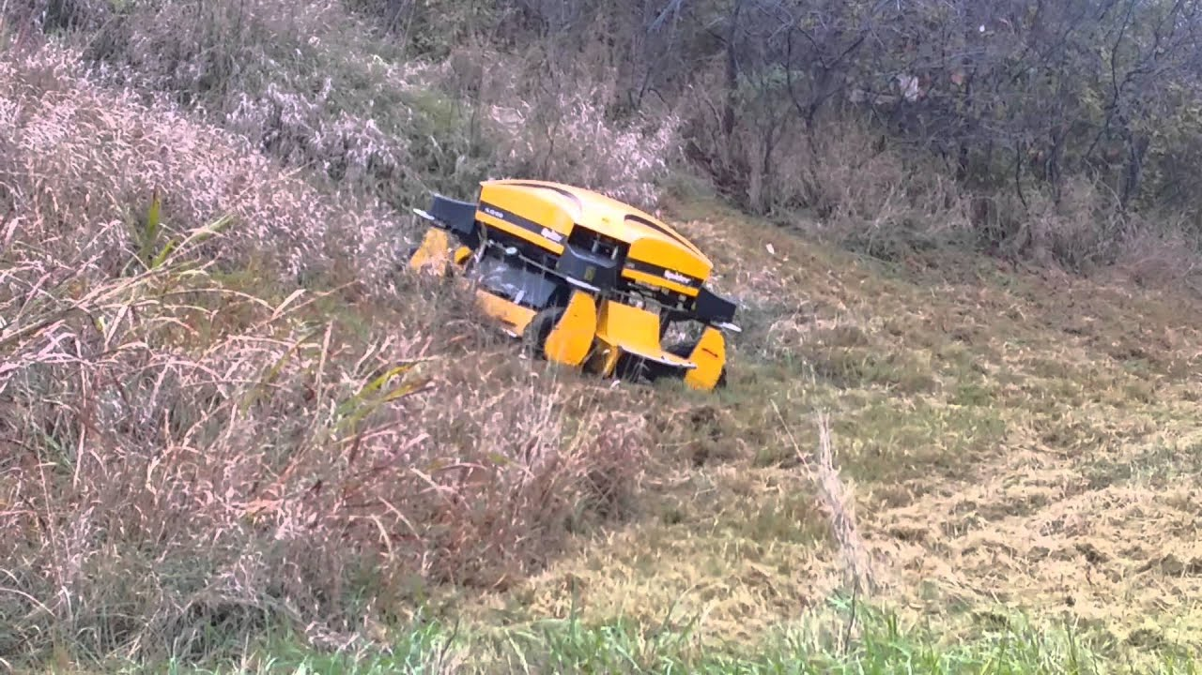
There has to be an easier way!

Slide 8
Constraints: Trees and Plants
2
1
ROBO
mulcher
3000
5
4
6
Need to find:
Closest Pair of Trees - how wide can the robot be?
7
3
8
8

Slide 9
Closest Pair of Points
Given:
A list of points
Return:
Pair of points with smallest distance apart
2
1
5
4
6
7
3
8

Slide 10
Closest Pair of Points: Naïve
Given:
A list of points
Return:
Pair of points with smallest distance apart
2
1
5
4
6
$$O(n^{2})$$
Algorithm:
Test every pair of points, return the closest.
7
3
We can do better!
8
$$Θ(n\log{n)}$$

Slide 11
Closest Pair of Points: D&C
Divide:
How?
2
1
At median x coordinate
Conquer:
5
4
6
Combine:
7
3
8
11

Slide 12
Closest Pair of Points: D&C
Divide:
2
1
At median x coordinate
Conquer:
5
4
Recursively find closest pairs from Left and Right
6
Combine:
7
3
8
12
LeftPoints
RightPoints

Slide 13
Closest Pair of Points: D&C
Divide:
2
1
At median x coordinate
Conquer:
5
4
Recursively find closest pairs from Left and Right
6
Combine:
7
Return min of Left and Right pairs
?
Problem?
3
8
13
LeftPoints
RightPoints

Slide 14
Closest Pair of Points: D&C
Combine:
2 Cases:
2
1
1. Closest Pair is completely in Left or Right
5
4
6
2. Closest Pair Spans our “Cut”
7
Need to test points across the cut
?
3
8
14
LeftPoints
RightPoints

Slide 15
Spanning the Cut
Combine:
2. Closest Pair Spanned our “Cut”
2
1
$$δ_{L}$$
Need to test points across the cut
5
$$δ_{R}$$
4
6
Compare all points within $δ=min⁡\{δ_{L}, δ_{R}\}$ of the cut.
(In the “runway”)
7
3
How many are there?
$$2δ$$
8
15
LeftPoints
RightPoints

Slide 16
Spanning the Cut
Combine:
2. Closest Pair Spanned our “Cut”
2
1
$$δ_{L}$$
Need to test points across the cut
4
5
Slow approach Compare all points within $δ=min⁡\{δ_{L}, δ_{R}\}$ of the cut.
$$δ_{R}$$
6
7
How many are there?
$$T\left(n\right)=2T\left(\frac{n}{2}\right)+{\left(\frac{n}{2}\right)}^{2}$$
3
$$2δ$$
8
$$=Θ\left(n^{2}\right)$$
LeftPoints
RightPoints
16

Slide 17
Spanning the Cut
Combine:
2. Closest Pair Spanned our “Cut”
2
1
$$δ_{L}$$
Need to test points across the cut
4
5
$$δ_{R}$$
We don’t need to test all pairs!
6
7
Don’t need to test points that are $>δ$ from one another
3
$$2δ$$
8
17
LeftPoints
RightPoints

Slide 18
Our Strategy for Combine Step
Before we go into details, let’s explain our strategy
Our goal: find the pair crossing the cut that has distance $<δ$ and whose distance is the minimum of such pairs
We want to avoid the following $Θ\left(n^{2}\right)$approach:
For each point in the runway, compare to all others in the runway to see if they cross the cut and are closer than $δ$
We’re going to find an approach that’s $Θ\left(n\right)$:
For each point in the runway, compare to $k$ near-by points in the runway to see if they cross the cut and are closer than $δ$
Doesn’t matter what $k$ is. As long as it’s a constant!
Here are 2 ways to find a valid $k$, both based on geometry

Slide 19
#1: Showing k=15 is Valid

Slide 20
Reducing Search Space
$$2⋅δ$$
Combine:
2. Closest Pair Spanned our “Cut”
Need to test points across the cut
Divide the “runway” into square cubbies of size $\frac{δ}{2}$
$$\frac{δ}{2}$$
Each cubby will have at most 1 point!
$$\frac{δ}{\sqrt{2}}$$
20

Slide 21
Reducing Search Space
$$2⋅δ$$
Combine:
2. Closest Pair Spanned our “Cut”
Need to test points across the cut
13
14
15
9
10
11
12
Divide the “runway” into square cubbies of size $\frac{δ}{2}$
5
6
7
8
How many cubbies could contain a point $<δ$ away?
Each point compared to $≤15$ other points
1
7
2
3
4

Slide 22
#2: Showing k=7 is Valid

Slide 23
Reducing Search Space
Combine:
$$2⋅δ$$
Need to test points across the cut
Claim #1: if two points are the closest pair that cross the cut, then you can surround them in a box that’s $2⋅δ$ wide by $δ$ tall.
$$δ$$
Let’s draw some examples.
23

Slide 24
Reducing Search Space
Assume you’re checking in increasing y-order, and you’ve reached the first point of the closest pair.
Do you have to look at all points above it to be guaranteed to find the other point and the minimum distance?
$$2⋅δ$$
$$δ$$
No!
Imagine you drew a box with its bottom at point’s y-coordinate.
See Claim #1.
Claim #2: only 8 points can be in the box.
Claim #1: if two points are the closest pair that cross the cut, then you can surround them in a box that’s $2⋅δ$ wide by $δ$ tall.
24

Slide 25
Spanning the Cut
Combine:
1
2
2. Closest Pair Spanned our “Cut”
$$δ_{L}$$
Consider points in runway in increasing y-order.
For a given point p, we can prove the 8th point and beyond is more than $δ$ from p.
(pp. 1041-2 in CLRS)
So for each point in runway, check next 7 points in y-order.
4
5
$$δ_{R}$$
Only check next 7
6
7
3
$$2δ$$
8
LeftPoints
RightPoints
$$Θ\left(n\right)$$
25

Slide 26
Closest Pair of Points: Divide and Conquer
Initialization: Sort points by $x$-coordinate
Divide: Partition points into two lists of points based on $x$-coordinate (split at the median $x$)
Conquer: Recursively compute the closest pair of points in each list
Base case?
Combine:
Construct list of points in the runway ($x$-coordinate within distance $δ$ of median)
Sort runway points by $y$-coordinate
Compare each point in runway to 7 or 15 points above it and save the closest pair
Output closest pair among left, right, and runway points
2
1
5
4
6
7
?
3
8
LeftPoints
RightPoints

Slide 27
Closest Pair of Points: Divide and Conquer
Initialization: Sort points by $x$-coordinate
Divide: Partition points into two lists of points based on $x$-coordinate (split at the median $x$)
Conquer: Recursively compute the closest pair of points in each list
Base case?
Combine:
Construct list of points in the runway ($x$-coordinate within distance $δ$ of median)
Sort runway points by $y$-coordinate
Compare each point in runway to 7 or 15 points above it and save the closest pair
Output closest pair among left, right, and runway points
2
1
But sorting is an $O\left(n\log{n}\right)$ algorithm – combine step is still too expensive! We need $O(n)$
5
4
6
7
?
3
8
LeftPoints
RightPoints

Slide 28
Closest Pair of Points: Divide and Conquer
Initialization: Sort points by $x$-coordinate
Divide: Partition points into two lists of points based on $x$-coordinate (split at the median $x$)
Conquer: Recursively compute the closest pair of points in each list
Base case?
Combine:
Construct list of points in the runway ($x$-coordinate within distance $δ$ of median)
Sort runway points by $y$-coordinate
Compare each point in runway to 7 or 15 points above it and save the closest pair
Output closest pair among left, right, and runway points
Solution: Maintain additional information in the recursion
Minimum distance among pairs of points in the list
List of points sorted according to $y$-coordinate
Sorting runway points by $y$-coordinate now becomes a merge

Slide 29
Listing Points in the Runway
Output on Left:
2
Closest Pair: $(1, 5)$, $δ_{1,5}$
1
Sorted Points: $[3,7,5,1]$
5
Output on Right:
4
Closest Pair: $(4,6)$, $δ_{4,6}$
6
Sorted Points: $[8,6,4,2]$
Merged Points: $\left[8,3,7,6,4,5,1,2\right]$
7
Runway Points: $\left[8,7,6,5,2\right]$
Both of these lists can be computed by a single pass over the lists
3
8
29
LeftPoints
RightPoints

Slide 30
Closest Pair of Points: Divide and Conquer
Initialization: Sort points by $x$-coordinate
Divide: Partition points into two lists of points based on $x$-coordinate (split at the median $x$)
Conquer: Recursively compute the closest pair of points in each list
Base case?
Combine:
Construct list of points in the runway ($x$-coordinate within distance $δ$ of median)
Sort runway points by $y$-coordinate
Compare each point in runway to 7 or 15 points above it and save the closest pair
Output closest pair among left, right, and runway points
Initialization: Sort points by $x$-coordinate
Divide: Partition points into two lists of points based on $x$-coordinate (split at the median $x$)
Conquer: Recursively compute the closest pair of points in each list
Combine:
Merge sorted list of points by $y$-coordinate and construct list of points in the runway (sorted by $y$-coordinate)
Compare each point in runway to 7 or 15 points above it and save the closest pair
Output closest pair among left, right, and runway points

Slide 31
Closest Pair of Points: Divide and Conquer
What is the running time?
$$Θ\left(n\log{n}\right)$$
Initialization: Sort points by $x$-coordinate
Divide: Partition points into two lists of points based on $x$-coordinate (split at the median $x$)
Conquer: Recursively compute the closest pair of points in each list
Combine:
Merge sorted list of points by $y$-coordinate and construct list of points in the runway (sorted by $y$-coordinate)
Compare each point in runway to 7 or 15 points above it and save the closest pair
Output closest pair among left, right, and runway points
$$Θ(n\log{n})$$
$$Θ\left(1\right)$$
$$2T(n/2)$$
$$T(n)$$
$$T(n)=2T(n/2)+Θ(n)$$
$$Θ\left(n\right)$$
$$Θ\left(n\right)$$
Case 2 of Master’s Theorem
$$T\left(n\right)=Θ\left(n\log{n}\right)$$
$$Θ\left(1\right)$$

Slide 32
Closest Pair of Points: D&C
0. Sort points by x
1. Divide: At median x
2
1
2. Conquer: If >2 points Recursively find closest pair on left and right
$$δ_{L}$$
5
$$δ_{R}$$
4
3. Combine:
6
a. List points in “runway” in order according to y value
b. Compare each point to the next 7/15 above it, save best found
7
3
c. Return min from left, right, and 3b
8
32

Slide 33
Listing points in “Runway”
Given: y-sorted lists from left and right
Return: y-sorted points in “runway”
Target run time?
2
1
$$O(n)$$
5
Left, sorted by y
Right, sorted by y
4
6
3
7
5
1
8
6
4
2
Merged, sorted by y
8
3
7
6
4
5
1
2
7
Runway, still sorted by y!
8
7
6
5
2
3
8
33

Slide 34
Run Time
0. Sort points by x
$$Θ(n\log{n})$$
One-time setup cost!
1. Divide: At median x
$$Θ(1)$$
2. Conquer: If >2 points, Recursively find closest pair on left and right
$$2T\left(\frac{n}{2}\right)$$
3. Combine:
a. Merge points to sort by y
$$Θ(n)$$
$$T\left(n\right)=2T\left(\frac{n}{2}\right)+Θ(n)$$
b. Compare each runway point to the next 7/15 runway points, save closest pair
Case 2!
$$Θ(n)$$
$$T\left(n\right)=Θ(n\log{n})$$
c. Return y-sorted points and min from left, right, and 3b
$$Θ(1)$$

Slide 35
Matrix Multiplication

Slide 36
Matrix Multiplication
$$n$$
$$\left[\begin{matrix}1 & 2 & 3 \\ 4 & 5 & 6 \\ 7 & 8 & 9\end{matrix}\right]×\left[\begin{matrix}2 & 4 & 6 \\ 8 & 10 & 12 \\ 14 & 16 & 18\end{matrix}\right]$$
$$n$$
$$=\left[\begin{matrix}2+16+42 & 4+20+48 & 6+24+54 \\ ⋅ & ⋅ & ⋅ \\ ⋅ & ⋅ & ⋅\end{matrix}\right]$$
$$=\left[\begin{matrix}60 & 72 & 84 \\ 132 & 162 & 192 \\ 204 & 252 & 300\end{matrix}\right]$$
Run time?
$$O(n^{3})$$

Slide 37
Matrix Multiplication D&C
Multiply $n×n$ matrices ($A$ and $B$)
Divide:
$$A=\left[\begin{matrix}a_{1} & a_{2} & a_{3} & a_{4} \\ a_{5} & a_{6} & a_{7} & a_{8} \\ a_{9} & a_{10} & a_{11} & a_{12} \\ a_{13} & a_{14} & a_{15} & a_{16}\end{matrix}\right]$$
$$B=\left[\begin{matrix}b_{1} & b_{2} & b_{3} & b_{4} \\ b_{5} & b_{6} & b_{7} & b_{8} \\ b_{9} & b_{10} & b_{11} & b_{12} \\ b_{13} & b_{14} & b_{15} & b_{16}\end{matrix}\right]$$

Slide 38
Matrix Multiplication D&C
Multiply $n×n$ matrices ($A$ and $B$)
$$A=\left[\begin{matrix}a_{1} & a_{2} & a_{3} & a_{4} \\ a_{5} & a_{6} & a_{7} & a_{8} \\ a_{9} & a_{10} & a_{11} & a_{12} \\ a_{13} & a_{14} & a_{15} & a_{16}\end{matrix}\right]$$
$$A_{1,1}$$
$$A_{1,2}$$
$$B=\left[\begin{matrix}b_{1} & b_{2} & b_{3} & b_{4} \\ b_{5} & b_{6} & b_{7} & b_{8} \\ b_{9} & b_{10} & b_{11} & b_{12} \\ b_{13} & b_{14} & b_{15} & b_{16}\end{matrix}\right]$$
$$B_{1,1}$$
$$B_{1,2}$$
$$A_{2,1}$$
$$A_{2,2}$$
$$B_{2,1}$$
$$B_{2,2}$$
Combine:
$$AB=\left[\begin{matrix}A_{1,1}B_{1,1}+A_{1,2}B_{2,1} & A_{1,1}B_{1,2}+A_{1,2}B_{2,2} \\ A_{2,1}B_{1,1}+A_{2,2}B_{2,1} & A_{2,1}B_{1,2}+A_{2,2}B_{2,2}\end{matrix}\right]$$
$$T\left(n\right)=8T\left(\frac{n}{2}\right)+4{\left(\frac{n}{2}\right)}^{2}$$
Cost of additions
Run time?

Slide 39
Matrix Multiplication D&C
$$T\left(n\right)=8T\left(\frac{n}{2}\right)+4{\left(\frac{n}{2}\right)}^{2}$$
$$T\left(n\right)=8T\left(\frac{n}{2}\right)+{Θ(n}^{2})$$
$$a=8, b=2, f\left(n\right)=n^{2}$$
Case 1!
$$n^{\log_{b}{a}}=n^{\log_{2}{8}}=n^{3}$$
$$T\left(n\right)=Θ(n^{3})$$
We can do better…

Slide 40
Matrix Multiplication D&C
Multiply $n×n$ matrices ($A$ and $B$)
$$A=\left[\begin{matrix}a_{1} & a_{2} & a_{3} & a_{4} \\ a_{5} & a_{6} & a_{7} & a_{8} \\ a_{9} & a_{10} & a_{11} & a_{12} \\ a_{13} & a_{14} & a_{15} & a_{16}\end{matrix}\right]$$
$$A_{1,1}$$
$$A_{1,2}$$
$$B=\left[\begin{matrix}b_{1} & b_{2} & b_{3} & b_{4} \\ b_{5} & b_{6} & b_{7} & b_{8} \\ b_{9} & b_{10} & b_{11} & b_{12} \\ b_{13} & b_{14} & b_{15} & b_{16}\end{matrix}\right]$$
$$B_{1,1}$$
$$B_{1,2}$$
$$A_{2,1}$$
$$A_{2,2}$$
$$B_{2,1}$$
$$B_{2,2}$$
$$AB=\left[\begin{matrix}A_{1,1}B_{1,1}+A_{1,2}B_{2,1} & A_{1,1}B_{1,2}+A_{1,2}B_{2,2} \\ A_{2,1}B_{1,1}+A_{2,2}B_{2,1} & A_{2,1}B_{1,2}+A_{2,2}B_{2,2}\end{matrix}\right]$$
Idea: Use a Karatsuba-like technique on this

Slide 41
Strassen’s Algorithm
Multiply $n×n$ matrices ($A$ and $B$)
$$A=\left[\begin{matrix}a_{1} & a_{2} & a_{3} & a_{4} \\ a_{5} & a_{6} & a_{7} & a_{8} \\ a_{9} & a_{10} & a_{11} & a_{12} \\ a_{13} & a_{14} & a_{15} & a_{16}\end{matrix}\right]$$
$$A_{1,1}$$
$$A_{1,2}$$
$$B=\left[\begin{matrix}b_{1} & b_{2} & b_{3} & b_{4} \\ b_{5} & b_{6} & b_{7} & b_{8} \\ b_{9} & b_{10} & b_{11} & b_{12} \\ b_{13} & b_{14} & b_{15} & b_{16}\end{matrix}\right]$$
$$B_{1,1}$$
$$B_{1,2}$$
$$A_{2,1}$$
$$A_{2,2}$$
$$B_{2,1}$$
$$B_{2,2}$$
Calculate:
Find $AB$:
$$Q_{1}=\left(A_{1,1}+A_{2,2}\right)(B_{1,1}+B_{2,2})$$
$$\left[\begin{matrix}Q_{1}+Q_{4}−Q_{5}+Q_{7} & Q_{3}+Q_{5} \\ Q_{2}+Q_{4} & Q_{1}−Q_{2}+Q_{3}+Q_{6}\end{matrix}\right]$$
$$Q_{2}=\left(A_{2,1}+A_{2,2}\right)B_{1,1}$$
$$Q_{3}=A_{1,1}(B_{1,2} −B_{2,2})$$
$$Q_{4}=A_{2,2}(B_{2,1}−B_{1,1})$$
$$\left[\begin{matrix}A_{1,1}B_{1,1}+A_{1,2}B_{2,1} & A_{1,1}B_{1,2}+A_{1,2}B_{2,2} \\ A_{2,1}B_{1,1}+A_{2,2}B_{2,1} & A_{2,1}B_{1,2}+A_{2,2}B_{2,2}\end{matrix}\right]$$
$$Q_{5}=\left(A_{1,1}+A_{1,2}\right)B_{2,2}$$
$$Q_{6}=\left(A_{2,1}−A_{1,1}\right)(B_{1,1}+B_{1,2})$$
Number Mults.: 7
Number Adds.: 18
$$Q_{7}=\left(A_{1,2}−A_{2,2}\right)(B_{2,1}+B_{2,2})$$
$$T\left(n\right)=7T\left(\frac{n}{2}\right)+\frac{9}{2}n^{2}$$

Slide 42
Strassen’s Algorithm
$$T\left(n\right)=7T\left(\frac{n}{2}\right)+\frac{9}{2}n^{2}$$
$$a=7, b=2, f\left(n\right)={\frac{9}{2}n}^{2}$$
Case 1!
$$n^{\log_{b}{a}}=n^{\log_{2}{7}}≈n^{2.807}$$
$$T\left(n\right)=Θ\left(n^{\log_{2}{7}}\right)≈Θ(n^{2.807})$$

Slide 43
Strassen’s Algorithm
$$n^{3}$$
$$n^{\log_{2}{7}}$$

Slide 44
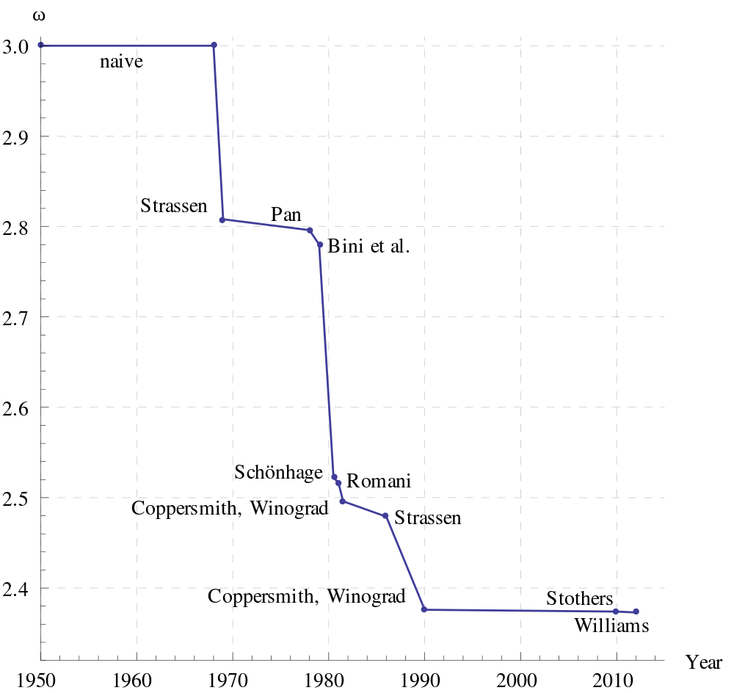
Is this the fastest?
Best possible is unknown
May not even exist!

