Slide 1
Kruskal’s MST Algorithm and Find-Union Data Structure
CS 4102: Algorithms
Spring 2022
Robbie Hott and Tom Horton

Slide 2
Topics in this slide-deck:
Motivating Problem: Minimum Spanning Trees
This is a graph problem, and you’ve seen it
One solution
Kruskal’s Algorithm (Uses a find-union structure)
Define and design the find-union to support Kruskal’s Algorithm
Will require some clever implementation details

Slide 3
Minimum Spanning Trees
Readings: CLRS 23 (but not 23.1 and only first part of 23.2)

Slide 4
Spanning Tree
A spanning tree of a graph G is a subgraph of G that contains every vertex in G and is also a tree (i.e., it has no cycles)
All connected graphs have spanning tree(s)
All spanning trees have the same number of nodes (all of them)
You can construct a spanning tree by arbitrarily remove edges from cycles

Slide 5
Spanning Tree: Example
Original Graph:
Possible spanning trees:

Slide 6
Spanning Tree: Example (almost)

Slide 7
Minimum Spanning Tree
Just constructing any spanning tree is simple
Suppose edges have costs!
Cost of building tracks between two stations
Length of wire between boxes in a house
Each spanning tree has a different total cost (sum of edges included in tree)
The Minimum Spanning Tree is the spanning tree with lowest overall cost

Slide 8
Minimum Spanning Tree
Given a connected and undirected graph G=(V, E)
Find a graph G’ = (V, E’) such that:
E’ is a subset of E
|E’| = |V| - 1
G’ is connected (assuming G was connected)
Sum of cost of edges in E’ is minimum
G’ is then the minimum spanning tree

Slide 9
Kruskal’s MST Algorithm
Readings: CLRS first part of 23.2

Slide 10
Kruskal’s MST Algorithm
Prim’s approach:
Build one tree. Make the one tree bigger and as good as it can be.
Kruskal’s approach
Choose the best edge possible: smallest weight
Not one tree – maintain a forest!
Each edge added will connect two trees. Can’t form a cycle in a tree!
After adding V-1 edges, you have one tree, the MST

Slide 11
Kruskal’s MST Algorithm
Idea: Have a forest (set of trees) that eventually shrinks into one tree
At each step, add an edge that joins two trees (no cycles!)
Choose the one (v,w) that has the smallest weight of possible connecting edges
Continue until you have one tree, which will be a MST
3
v
w
7
6
4
G=(V,E)

Slide 12
MST Example
2
v₂
v₁
4
1
3
10
v₃
2
v₄
7
v₅
5
8
4
6
v₆
1
v₇

Slide 13
MST and Kruskal’s Example
2
v₂
v₁
4
1
3
10
v₃
2
v₄
7
v₅
5
8
v₁
v₂
4
6
1
v₃
v₄
v₅
v₆
v₇
v₇
v₆
Cost(MST) = 16

Slide 14
Kruskal code
void Graph::kruskal(){
int edgesAccepted = 0;
DisjSet s(NUM_VERTICES);
while (edgesAccepted < NUM_VERTICES – 1){
e = smallest weight edge not deleted yet;
// edge e = (u, v)
uset = s.find(u);
vset = s.find(v);
if (uset != vset){
edgesAccepted++;
s.unionSets(uset, vset);
}
}
}
Assumes we’ve created a heap. (Could we sort?)
Initialize DisjSet object so all items in separate set
|E| heap ops
2|E| finds
|V| unions

Slide 15
Runtime of Kruskal’s
Every edge is placed on priority queue once and removed once
$Θ\left(E∗\log\left(E\right)\right)=Θ(E∗\log\left(V\right))$
For each edge you do 2 set finds and one set union.
Let f(V) be time of find, and u(V) be time of union.
$Θ\left(E∗\left(2f\left(V\right)+u\left(V\right)\right)\right)$
If find and union are linear time, then $Θ\left(E∗\left(2V+V\right)\right)=Θ\left(E∗V\right)=O(V^{3})$
Overall: $Θ\left(E∗\log\left(V\right)+E∗V\right)=Θ\left(E∗V\right)=O\left(V^{3}\right)$ //Assumes find and union linear time

Slide 16
Strategy for Kruskal’s
EL = sorted set of edges ascending by weight
(For this discussion, we’re sorting here, not using a heap)
Foreach edge e in EL
T1 = tree for head(e)
T2 = tree for tail(e)
If (T1 != T2)
add e to the output (the MST)
Combine trees T1 and T2
Seems simple, no?
But, how do you keep track of what trees a vertex is in?
Trees are sets of vertices. Need to findset(v) and “union” two sets

Slide 17
Disjoint Sets and Find/Union Algorithms
Readings: CLRS 21.3

Slide 18
Union/Find and Disjoint Sets
An Abstract Data Type (ADT) for a collection of sets of any kind of item, where an item can only belong to one of the sets
We’ll assume each item is identified by a unique integer value
Need to support the following operations
void makeSet(int n) // construct n independent sets
int findSet(int i) // given i, which set does i belong to?
void union(int i, int j) // merge sets containing i and j

Slide 19
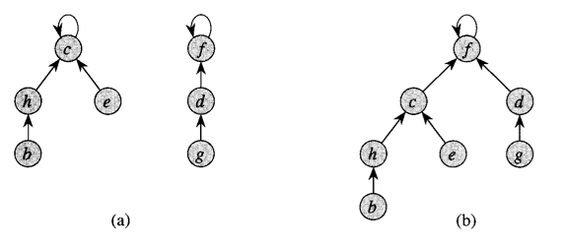
Represent Sets As Trees
In our implementation, we’ll represent each set as a tree
Identify set by its root node’s ID (its “label”)
findSet() means tracing up to root
union() makes one root child of the other root
Two sets
After a union

Slide 20
Union/Find and Disjoint Sets
Needs to support the following operations
void makeSet(int n) //construct n independent sets
Solution:
Store as array of size n. Each location stores label for that set.
0 1 2 3 4 5 6 7
0 1 2 3 4 5 6 7

Slide 21
Union/Find and Disjoint Sets
Needs to support the following operations
int findSet(int i) //given i, which set does i belong to?
Solution: Trace around array until we find place where index and contents match
Start at index i and repeat:
If a[i] == i then return i
Else set i = a[i]
0 1 2 3 4 5 6 7
0 1 2 3 4 5 6 7

Slide 22
Union/Find and Disjoint Sets
Needs to support the following operations
void union(int i, int j) //merge sets i and j
Solution: find label for each set (call find() method), then set one label to point to other
Label1 = find(i); Label2 = find(j)
a[Label1] = Label2 //OR a[Label2] = Label1
0 1 2 3 4 5 6 7
0 1 2 3 4 5 6 7

Slide 23
Union/Find and Disjoint Sets
Example:
union(4,5)
union(6,7)
union(1,2)
union(5,6)
find(1); find(4); find(6)
0 1 2 3 4 5 6 7
0 1 2 3 4 5 6 7

Slide 24
Example Using MST Example
2
v₁
v₂
4
1
3
10
2
7
v₃
v₄
v₅
8
6
5
4
1
v₆
v₇
v₁
v₂
v₃
v₄
v₅
v₆
v₇

Slide 26
Union/Find and Disjoint Sets
Time-complexity, where n is size of array?
makeSet()
Linear: just create array and fill it with values
find()
Linear if have to trace a long way to get to label
Constant if lucky and input is the label (root note) or near it
union()
Constant to change the label BUT…
Could be linear to find the two labels first.

Slide 27
Optimization 1: Union by rank
Two Sets: Union’d under 0: Union’d under 3:

Slide 28
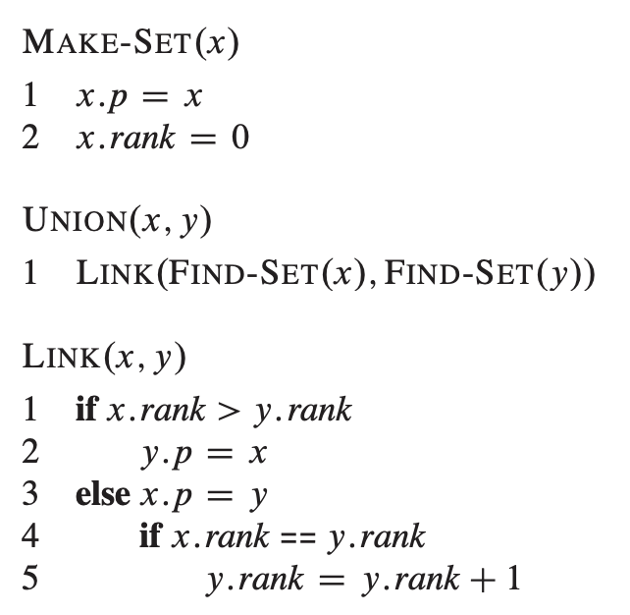
Optimization 1: Union by rank
Easy to implement!!
What’s “rank” here?
Upper bound on height of a node in our set’s tree
Union by rank:
Make the root with smaller rank point to the root with larger rank

Slide 29
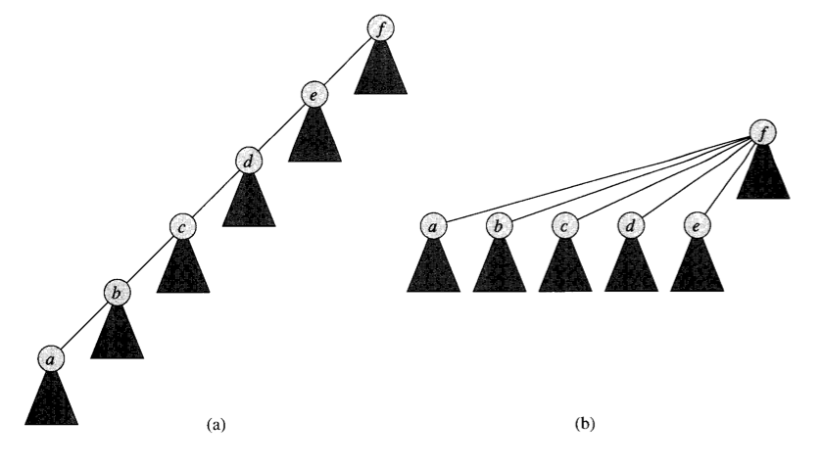
Optimization 2: Path Compression
Nothing special about tree’s structure, as long as we can trace back to root
Idea: as we do a find, each node we visit gets updated to point directly to root
Later finds will be faster

Slide 30
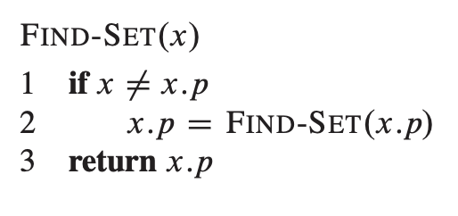
Optimization 2: Path Compression
Also easy to implement
CLRS code uses recursion →
Or would loop and keep a list
def find_set(x): path = [] while x != x.p:
path.append(x)
x = x.p
for n in path:
n.p = x.p
return x.p

Slide 31
Complexity for Kruskal’s
Union-by-rank and path compression yields m operations in $Θ\left(m∗α\left(n\right)\right)$
where $α\left(n\right)$ a VERY slowly growing function. (See textbook for details)
m is the number of times you run the operation. So constant time, for each operation
So overall Kruskal’s with path compression:
$Θ\left(E∗\log\left(V\right)+E∗1\right)=Θ(E∗\log\left(V\right))$ //now the heap is slowest part
Originally: $Θ\left(E∗\log\left(V\right)+E∗V\right)=Θ\left(E∗V\right)=O\left(V^{3}\right)$ //Assumed find and union linear time
(Time complexity if we’d sorted edges and not used a heap?)

Slide 32
Summary

Slide 33
What did we learn?
Minimum Spanning Trees
Review!
Kruskal’s Algorithm
Review again!
Find-union
How to implement
How to optimize
How it affects runtime of Kruskal’s algorithm.

