Slide 1
CS4102 Algorithms Spring 2022

Slide 2
Today’s Keywords
Reductions
Bipartite Matching
Vertex Cover
Independent Set
NP Completeness
CLRS: Ch 34

Slide 3
Reductions
Algorithm technique of supreme ultimate power
Convert instance of problem A to an instance of Problem B
Convert solution of problem B back to a solution of problem A

Slide 4
Reductions
Shows how two different problems relate to each other
MOVIE TIME!

Slide 5
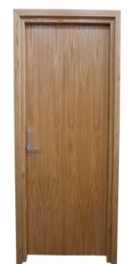
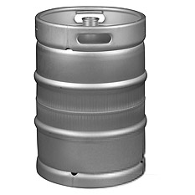
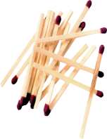
MacGyver’s Reduction
Problem we don’t know how to solve
Problem we do know how to solve
$$A$$
Opening a door
Aim duct at door, insert keg
Lighting a fire
$$B$$
How?
Solution for $A$
Solution for $B$
Keg cannon battering ram
Alcohol, wood, matches
Put fire under the Keg
Reduction

Slide 6
In General: Reduction
Problem we don’t know how to solve
Problem we do know how to solve
$$A$$
Map Instances of problem $A$to Instances of $B$
$$B$$
Injective: any instance of A can be mapped to some instance of B.
Using any Algorithm for $B$
Map Solutions of problem $B$to Solutions of $A$
Solution for $A$
Solution for $B$
$$X$$
$$Y$$
Reduction

Slide 7
Worst-case lower-bound Proofs
Opening a door
Lighting a fire
$$A$$
reduces to
$$B$$
Problem B
Problem A
Alcohol, wood, matches
can be used to make
Keg cannon battering ram
$$Y$$
$$X$$
Algorithm for B
Algorithm for A
$A$ is not a harder problem than $B$
$A≤B$
The name “reduces” is confusing: it is in the opposite direction of the making

Slide 8
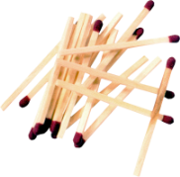
Proof of Lower Bound by Reduction
To Show: $Y$ is slow
$$X$$
1. We know X is slow (by a proof)
(e.g., X = some way to open the door)
$$Y$$
2. Assume Y is quick [toward contradiction]
(Y = some way to light a fire)
$$X$$
$$Y$$
3. Show how to use Y to perform X quickly
4. X is slow, but Y could be used to perform X quickly
conclusion: Y must not actually be quick

Slide 9
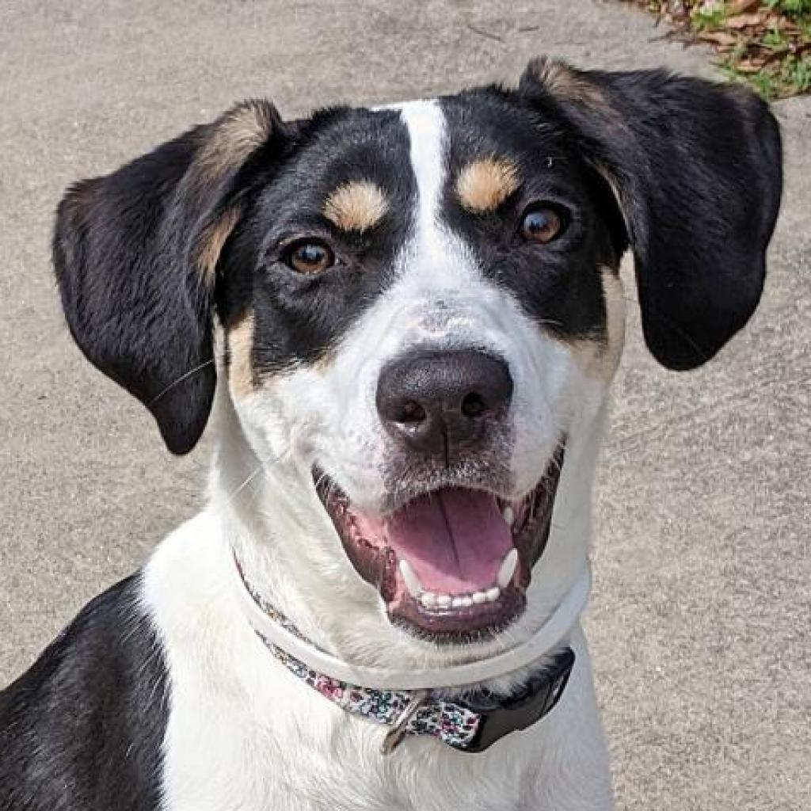
Maximum Bipartite Matching
Dog Lovers
Dogs

Slide 10
Maximum Bipartite Matching Using Max Flow
Make $G=(L,R,E)$ a flow network $G^{′}=(V^{′},E^{′})$ by:
Adding in a source and sink to the set of nodes:
$V^{′}=L∪R∪\{s,t\}$
Adding an edge from source to $L$ and from $R$ to sink:
$E^{′}=E∪\left\{u∈L \right| \left(s,u\right)\}∪\left\{v∈r \right| \left(v,t\right)\}$
Make each edge capacity $1$:
$∀e∈E^{′}, c\left(e\right)=1$
1
1
1
1
1
1
$$s$$
1
1
1
Remember: need to show
How to map instance of MBM to MF (and back) - construction
A valid solution to MF instance is a valid solution to MBM instance
1
$$t$$
1
1
1
1
1
1
1

Slide 11
Bipartite Matching Reduction
Problem we don’t know how to solve
Problem we do know how to solve
Bipartite Matching
Max Flow
$$A$$
$$B$$
3
2
$$s$$
3
1
3
1
2
$$t$$
1
1
1
1
2
3
1
1
1
2
$$s$$
1
1
3
1
1
1
$$t$$
1
1
1
1
1
Ford Fulkerson
1/1
0/1
Solution for $A$
1/1
0/1
1/1
Solution for $B$
1/1
1/1
1/1
2
$$s$$
0/1
$$t$$
1
1/1
0/1
1/1
0
2
1/1
2
1/1
1
1/1
0/1
1/1
$$s$$
1
1
2
0
3
$$t$$
0
2
3
1
1
Must show (prove): 1) how to make construction
2) Why it works
1
Reduction
2

Slide 12
Edge-Disjoint Paths
Given a graph $G=(V,E)$, a start node $s$ and a destination node $t$, give the maximum number of paths from $s$ to $t$ which share no edges
$$s$$
g
Set of edge-disjoint paths of size 4
h
f
$$t$$
e
b
c
a

Slide 13
Edge-Disjoint Paths Algorithm
Make $s$ and $t$ the source and sink, give each edge capacity $1$, find the max flow.
1
$$s$$
g
Set of edge-disjoint paths of size 4
1
1
1
1
h
1
f
1
1
1
1
$$t$$
e
b
1
1
1
c
1
a
1

Slide 14
Max-flow vs. Edge-disjoint paths
These two problems are “related”
Here we’re saying: if you can solve Max-flow, you can solve Edge-disjoint path
Alternatively, we can say that one problem reduces to the other
The problem of finding Edge-disjoint paths reduces to the problem of finding max-flow
Maybe this reduction requires some work to “convert”
Could be nothing or minimal
For these problems, the cost of the conversion is hopefully small (more on this in a moment).

Slide 15
Vertex-Disjoint Paths
Given a graph $G=(V,E)$, a start node $s$ and a destination node $t$, give the maximum number of paths from $s$ to $t$ which share no vertices
$$s$$
g
Not a vertex-disjoint path!
h
f
$$t$$
e
b
c
a

Slide 16
Vertex-Disjoint Paths Algorithm
Idea: Convert an instance of the vertex-disjoint paths problem into an instance of edge-disjoint paths
Make two copies of each node, one connected to incoming edges, the other to outgoing edges
Compute Edge-Disjoint paths on new graph
$$s$$
g
Restricts to 1 edge
1
g in
g out
1
1
h
f
1
$$t$$
e
b
c
a

Slide 17
In General: Reduction
Problem we don’t know how to solve
Problem we do know how to solve
$$A$$
Map Instances of problem $A$to Instances of $B$
$$B$$
Remember: need to show
How to map instance of A to B (and back)
Why solution to B was a valid solution to A
Using any Algorithm for $B$
Map Solutions of problem $B$to Solutions of $A$
Solution for $A$
Solution for $B$
$$X$$
$$Y$$
Reduction

Slide 18
Reduction
A reduction is a transformation of one problem into another problem
Edge-disjoint paths is reducible to max-flow because we can use max-flow to solve it
Formally, problem A is reducible to problem B if we can use a solution to B to solve A
We’re particularly interested in reductions that happen fast!
Meaning the work to do the conversion is fast (how fast?)
If A is polynomial-time reducible to B, we denote this as: A ≤_{p} B
If the conversion takes linear time, we might say $A≤_{n}B$

Slide 19
Worst-case lower-bound Proofs
Opening a door
Lighting a fire
$$A$$
reduces to
$$B$$
Problem B
Problem A
Alcohol, wood, matches
can be used to make
Keg cannon battering ram
$$Y$$
$$X$$
Algorithm for B
Algorithm for A
$A$ is not a harder problem than $B$
$A≤B$
The name “reduces” is confusing: it is in the opposite direction of the making

Slide 20
Bipartite Matching Reduction
Problem we don’t know how to solve
Problem we do know how to solve
Bipartite Matching
Max Flow
$$A$$
$$B$$
3
2
$$s$$
3
1
3
1
2
$$t$$
1
1
1
1
2
3
1
1
1
2
$$s$$
1
1
3
1
1
1
$$t$$
1
1
1
1
1
Ford Fulkerson
Then this is fast
If this is fast
1/1
0/1
Solution for $A$
1/1
0/1
1/1
Solution for $B$
1/1
1/1
1/1
2
$$s$$
0/1
$$t$$
1
1/1
0/1
1/1
0
2
1/1
2
1/1
1
1/1
0/1
1/1
$$s$$
1
1
2
0
3
$$t$$
0
2
3
1
1
1
Reduction
2

Slide 21
Bipartite Matching Reduction
Problem we don’t know how to solve
Problem we do know how to solve
Bipartite Matching
Max Flow
$$A$$
$$B$$
3
2
$$s$$
3
1
3
1
2
$$t$$
1
1
1
1
2
3
1
1
1
2
$$s$$
1
1
3
1
1
1
$$t$$
1
1
1
1
1
Ford Fulkerson
If this is slow
Then this is slow
1/1
0/1
Solution for $A$
1/1
0/1
1/1
Solution for $B$
1/1
1/1
1/1
2
$$s$$
0/1
$$t$$
1
1/1
0/1
1/1
0
2
1/1
2
1/1
1
1/1
0/1
1/1
$$s$$
1
1
2
0
3
$$t$$
0
2
3
1
1
1
Reduction
2

Slide 22
Total Runtime
The total runtime to solve A is:
Convert(A->B): Time it takes to convert problem A into problem B
Execute(B): Time it takes to execute algorithm to solve B
Solve(B->A): Time to convert solution of B back to solution of A
Total Runtime: Convert(A->B) + Execute(B) + Solve(B->A)
Do you see why we want convert() and solve() to be FAST. We want the slowest part to be the actual algorithm that solves B if possible.

Slide 23
Relative Hardness
Total Runtime: Convert(A->B) + Execute(B) + Solve(B->A)
Generally, we want execute() to be the slowest term, we then can say $A≤_{α}B$ where alpha is the runtime of convert() and solve()
If Execute() IS the slowest part, then what does that mean about the relative difficulty of solving A versus B??
It means that B is as hard or harder than A. Why?
Because B provides an algorithm that solves A, so if algorithm to solve B gets faster, so does the algorithm that solves A.

Slide 24
Reduction for Bipartite Matching
We have transformed (in polynomial time) a bipartite matching problem into a max flow problem
Specifically, bipartite-matching ≤_{p} max-flow
Because we can transform bipartite matching to max-flow in polynomial time
But is it the case that max-flow ≤_{p} bipartite-matching?
Not so much: a solution to bipartite matching does not help us with a non-bipartite graph

Slide 25
Proof of Lower Bound by Reduction
To Show: $Y$ is slow
$$X$$
1. We know X is slow (by a proof)
(e.g., X = some way to open the door)
$$Y$$
2. Assume Y is quick [toward contradiction]
(Y = some way to light a fire)
$$X$$
$$Y$$
3. Show how to use Y to perform X quickly
4. X is slow, but Y could be used to perform X quickly
conclusion: Y must not actually be quick

Slide 26
Reduction Proof Notation
$$A$$
$$B$$
$f(n)$-reduces to
Problem B
Problem A
$$Y$$
$$X$$
can be used to make
With $O(f\left(n\right))$ overhead
Algorithm for B
Algorithm for A
$A$ is not a harder problem than $B$
$A≤B$
Or we could have solved A faster using B’s solver!
If $A$ requires time $Ω(f\left(n\right))$ time then $B$ also requires $Ω(f\left(n\right))$ time
$A≤_{f(n)}B$

Slide 27
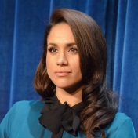
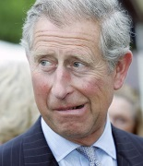
Party Problem
Draw Edges between people who don’t get along
Find the maximum number of people who get along

Slide 28
Maximum Independent Set
Independent set: $S⊆V$ is an independent set if no two nodes in $S$ share an edge
Maximum Independent Set Problem: Given a graph $G=(V,E)$ find the maximum independent set $S$

Slide 29
Example
Independent set of size 6

Slide 30
Generalized Baseball

Slide 31
Generalized Baseball
Need to place defenders on bases such that every edge is defended
What’s the fewest number of defenders needed?

Slide 32
Minimum Vertex Cover
Vertex Cover: $C⊆V$ is a vertex cover if every edge in $E$ has one of its endpoints in $C$
Minimum Vertex Cover: Given a graph $G=(V,E)$ find the minimum vertex cover $C$

Slide 33
Example
Vertex cover of size 5

Slide 34
MaxIndSet$≤_{V}$MinVertCov
$$A$$
$$B$$
$O(V)$-reduces to
Problem B
Problem A
$$Y$$
$$X$$
can be used to make
With $O(V)$ overhead
Algorithm for B
Algorithm for A
If $A$ requires time $Ω(f\left(n\right))$ time then $B$ also requires $Ω(f\left(n\right))$ time
$A≤_{V}B$

Slide 35
We need to build this Reduction
MaxIndSet
O(V) Time
MinVertCov
$$A$$
Relate Instances of MaxIndSet
to Instances of MinVertCov
$$B$$
Using any Algorithm for MinVertCov
Relate Solutions of MinVertCov to Solutions of MaxIndSet
Solution for MaxIndSet
Solution for MinVertCov
$$X$$
$$Y$$
Reduction

Slide 36
Reduction Idea
$S$ is an independent set of $G$ iff $V−S$ is a vertex cover of $G$
Independent Set
Vertex Cover

Slide 37
Reduction Idea
$S$ is an independent set of $G$ iff $V−S$ is a vertex cover of $G$
Vertex Cover
Independent Set

Slide 38
MaxVertCov $V$-Time Reducible to MinIndSet
MaxIndSet
O(V) Time
MinVertCov
$$A$$
$$B$$
Do nothing
Using any Algorithm for MinVertCov
Solution for MaxIndSet
Take complement of solution
Solution for MinVertCov
$$X$$
$$Y$$
Reduction

Slide 39
Proof: $⇒$
$S$ is an independent set of $G$ iff $V−S$ is a vertex cover of $G$
Let $S$ be an independent set
Consider any edge $\left(x,y\right)∈E$
If $x∈S$ then $y∉S$, because otherwise $S$ would not be an independent set
Therefore $y∈V−S$, so edge $(x,y)$ is covered by $V−S$

Slide 40
Proof: $⇐$
$S$ is an independent set of $G$ iff $V−S$ is a vertex cover of $G$
Let $V−S$ be a vertex cover
Consider any edge $\left(x,y\right)∈E$
At least one of $x$ and $y$ belong to $V−S$, because $V−S$ is a vertex cover
Therefore $x$ and $y$ are not both in $S$,
No edge has both end-nodes in $S$, thus $S$ is an independent set

Slide 41
MaxVertCov $V$-Time Reducible to MinIndSet
MaxIndSet
O(V) Time
MinVertCov
$$A$$
$$B$$
Do nothing
Using any Algorithm for MinVertCov
Solution for MaxIndSet
Take complement of solution
Solution for MinVertCov
$$X$$
$$Y$$
Reduction

Slide 42
MaxVertCov $V$-Time Reducible to MinIndSet
MaxIndSet
O(V) Time
MinVertCov
$$A$$
$$B$$
Do nothing
We needed our proof to show that this works!
Using any Algorithm for MinVertCov
Solution for MaxIndSet
Take complement of solution
Solution for MinVertCov
$$X$$
If there was a larger independent set, there would have been a smaller vertex cover!
$$Y$$
Reduction

Slide 43
MaxIndSet $V$-Time Reducible to MinVertCov
MaxIndSet
MinVertCov
O(V) Time
$$A$$
$$B$$
Do nothing
Using any Algorithm for MaxIndSet
Solution for MinVertCov
Take complement of solution
Solution for MaxIndSet
$$X$$
$$Y$$
Reduction

Slide 44
Corollary
MaxIndSet
O(V) Time
MinVertCov
$$A$$
$$B$$
Do nothing
Using any Algorithm for MinIndSet
If Solving $A$ was always slow
Then this shows solving $B$ is also slow
Solution for MaxIndSet
Take complement of solution
Solution for MinVertCov
$$X$$
$$Y$$
Reduction

Slide 45
Corollary
MaxIndSet
MinVertCov
O(V) Time
$$A$$
$$B$$
Do nothing
Using any Algorithm for MaxVertCov
If Solving $A$ was always slow
Then this shows solving $B$ is also slow
Solution for MinVertCov
Take complement of solution
Solution for MaxIndSet
$$X$$
$$Y$$
Reduction

Slide 46
Conclusion
MaxIndSet and MinVertCov are either both fast, or both slow
Spoiler alert: We don’t know which!
(But we think they’re both slow)
Both problems are NP-Complete

Slide 47
Why Study NP-Completeness
All semester, we’ve studied finding algorithms to solve problems using various tools.
Sometimes we instead need to prove that a problem is extremely hard, so as not to waste time on it!
NP-Complete Problems are hard
Let’s go over a few of them quickly
Let’s show how to prove a new problem is NP-Complete

Slide 48
Mid-class warm up:
What is a Decision Problem?

Slide 49
Some Preliminaries
Before we go further on this topic….
This is a complex (and interesting!) topic in CS theory
In our few lectures, we may approach things from a simpler viewpoint than you’d get in a CS theory course
The math and theory related to NP-complete problems starts with decision problems
What’s that? Let’s use vertex cover as an example
What’s described next applies to any optimization problems we’ve seen

Slide 50
Max Independent Set
Find the largest set of non-adjacent nodes

Slide 51
$k$ Independent Set
Is there a set of non-adjacent nodes of size $k$?

Slide 52
Maximum Independent Set
Independent set: $S⊆V$ is an independent set if no two nodes in $S$ share an edge
Maximum Independent Set Problem: Given a graph $G=(V,E)$ find the maximum independent set $S$

Slide 53
$k$ Independent Set
Independent set: $S⊆V$ is an independent set if no two nodes in $S$ share an edge
$k$ Independent Set Problem: Given a graph $G=(V,E)$ and a number $k$, determine whether there is an independent set $S$ of size $k$

Slide 54
Min Vertex Cover
Find the smallest set of nodes which covers every edge

Slide 55
$k$ Vertex Cover
Is there a set of nodes of size $k$ which covers every edge?

Slide 56
Minimum Vertex Cover
Vertex Cover: $C⊆V$ is a vertex cover if every edge in $E$ has one of its endpoints in $C$
Minimum Vertex Cover: Given a graph $G=(V,E)$ find the minimum vertex cover $C$

Slide 57
$k$ Vertex Cover
Vertex Cover: $C⊆V$ is a vertex cover if every edge in $E$ has one of its endpoints in $C$
$k$Vertex Cover: Given a graph $G=(V,E)$ and a number $k$, determine if there is a vertex cover $C$ of size $k$

Slide 58
Forms of the Vertex Cover Problem
Vertex Cover: $C⊆V$ is a vertex cover if every edge in $E$ has one of its endpoints in $C$
Minimum Vertex Cover Problem: Given a graph $G=(V,E)$ find the minimum vertex cover $C$
Result is C, a set of vertices
$k$Vertex Cover Problem: Given a graph $G=(V,E)$ and an integer $k$, determine if there is a vertex cover $C$ of size $k$
Result is True or False
This is the decision problem form of Vertex Cover

Slide 59
k Vertex Cover
$k$Vertex Cover Problem: Given a graph $G=(V,E)$ and an integer $k$, determine if there is a vertex cover $C$ of size $k$
True for k=6
True for k=5
Is 5 the smallest? True for k=4?

Slide 60
Problem Types
Decision Problems:
Is there a solution?
Result is True/False
E.g. Is there a vertex cover of size $k$?
Optimal Value Problems:
E.g. What’s the min k for k-vertex cover decision problem?
Search Problems:
Find a solution
Result more complex than T/F or a $k$
E.g. Find a vertex cover of size $k$
Verification Problems:
Given a potential solution for an input, is that input valid?
Result is True/False
For decision problem, check solution to its search problem
E.g. Is set of vertices a vertex cover of size $k$?
If we can solve this…
Looking ahead: We’ll use this to define a problem classes P and NP
…Then we can solve this,… …and also this
Looking ahead: We’ll use this to define a problem class called NP

Slide 61
Problem Types
Decision Problems:
Is there a solution?
Output is True/False
Is there a vertex cover of size $k$?
Search Problems:
Find a solution
Output is complex
Give a vertex cover of size $k$
Verification Problems:
Given a potential solution, is it valid?
Output is True/False
Is this a vertex cover of size $k$?
If we can solve this
Then we can solve this

Slide 62
Using a $k$-VertexCover decider to build a searcher
Set $i=k−1$
Remove nodes (and incident edges) one at a time
Check if there is a vertex cover of size $i$
If so, then that removed node was part of the $k$ vertex cover, set $i=i−1$
Else, it wasn’t
Did I need this node to cover its edges to have a vertex cover of size k?

Slide 63
$5$ Vertex Cover (Decision)
Is there a set of nodes of size $5$ which covers every edge?
Yes!

Slide 64
$4$ Vertex Cover (Decision)
Is there a set of nodes of size $4$ which covers every edge?
No!

Slide 65
$4$ Vertex Cover (Decision)
Is there a set of nodes of size $4$ which covers every edge?
Yes!

Slide 66
$3$ Vertex Cover (Decision)
Is there a set of nodes of size $3$ which covers every edge?
No!

Slide 67
Reduction
$k$-VertexCover Solver
$k$-VertexCover Decider
$$A$$
Remove a node, etc…
$$B$$
Using any Algorithm for $B$
Relate Solutions of problem $B$to Solutions of $A$
Solution for $A$
Solution for $B$
$$X$$
$$Y$$
Reduction

Slide 68
P vs NP
P
Deterministic Polynomial Time
Problems solvable in polynomial time
$O(n^{p})$ for some number $p$
NP
Non-Deterministic Polynomial Time
Problems verifiable in polynomial time
$O(n^{p})$ for some number $p$
Open Problem: Does P=NP?
Certainly $P⊆NP$
NP
P

Slide 69
$k$-Independent Set is NP
To show: Given a potential solution, can we verify it in $O(n^{p})$? $[n=V+E]$
How can we verify it?
Check that it’s of size $k$ $O(V)$
Check that it’s an independent set $O(V^{2})$

Slide 70
NP-Hard
How can we try to figure out if P=NP?
Identify problems at least as “hard” as NP
If any of these “hard” problems can be solved in polynomial time, then all NP problems can be solved in polynomial time.
Definition: NP-Hard:
$B$ is NP-Hard if $∀A∈NP, A≤_{p}B$
$A≤_{p}B$ means $A$ reduces to $B$ in polynomial time
NP-H
At least as “hard” as NP
NP
P

Slide 71
NP-Hardness Reduction
Any NP-Hard Problem
$$O(n^{p})$$
Problem to show is NP-Hard
$$A$$
$$B$$
Then this could be done in polynomial time
If This could be done in Polynomial time
Solution for $A$
Solution for $B$
$$X$$
$$Y$$
Reduction

Slide 72
NP-Complete
“Together they stand, together they fall”
Problems solvable in polynomial time iff ALL NP problems are
NP-Complete = NP $∩$ NP-Hard
How to show a problem is NP-Complete?
Show it belongs to NP
Give a polynomial time verifier
Show it is NP-Hard
Give a reduction from another NP-H problem
NP-H
NP-C
NP
P
We now just need a FIRST NP-Hard problem

Slide 73
NP-Completeness
Any NP-Complete Problem
$$O(n^{p})$$
Any other NP-Complete Problem
$$A$$
$$B$$
Then this could be done in polynomial time
If This could be done in polynomial time
Solution for $A$
Solution for $B$
$$X$$
$$Y$$
Reduction

Slide 74
NP-Completeness
Any NP-Complete Problem
$$O(n^{p})$$
Any other NP-Complete Problem
$$A$$
$$B$$
If this cannot be done in polynomial time
Then this cannot be done in polynomial time
Solution for $A$
Solution for $B$
$$X$$
$$Y$$
Reduction

Slide 75
3-SAT
Shown to be NP-Hard by Cook and Levin (independently)
Given a 3-CNF formula (logical AND of clauses, each an OR of 3 variables), Is there an assignment of true/false to each variable to make the formula true?
$$\left(x∨y∨z\right)∧\left(x∨\overline{y}∨y\right)∧\left(u∨y∨\overline{z}\right)∧\left(z∨\overline{x}∨u\right)∧(\overline{x}∨\overline{y}∨\overline{z})$$
Clause
$$x=true$$
$$y=false$$
$$z=false$$
$$u=true$$
Variables

Slide 76
$k$-Independent Set is NP-Complete
Show that it belongs to NP
Give a polynomial time verifier (slide 56)
Show it is NP-Hard
Give a reduction from a known NP-Hard problem
Show $3SAT≤_{p}kIndSet$

Slide 77
$$3SAT≤_{p}kIndSet$$
3SAT
$$O(n^{p})$$
$k$-Ind Set
$$A$$
$$B$$
Solution for 3SAT
Solution for $k$-Ind Set
$$X$$
$$Y$$
Reduction

Slide 78
Instance of 3SAT to Instance of $k$IndSet
$$\left(x∨y∨z\right)∧\left(x∨\overline{y}∨y\right)∧\left(u∨y∨\overline{z}\right)∧\left(z∨\overline{x}∨u\right)∧(\overline{x}∨\overline{y}∨\overline{z})$$
$$x$$
$$u$$
$$z$$
$$\overline{u}$$
$$x$$
$$y$$
$$\overline{y}$$
$$\overline{z}$$
$$y$$
$$u$$
$$\overline{x}$$
$$\overline{z}$$
$$\overline{y}$$
$$z$$
$$y$$
For each clause, produce a triangle graph with its three variables as nodes
Connect each node to all of its opposites
Let $k=$ number of clauses
There is a $k$-IndSet in this graph, iff there is a satisfying assignment

Slide 79
$k$IndSet $⇒$ Satisfying Assignment
$$\left(x∨y∨z\right)∧\left(x∨\overline{y}∨y\right)∧\left(u∨y∨\overline{z}\right)∧\left(z∨\overline{x}∨u\right)∧(\overline{x}∨\overline{y}∨\overline{z})$$
$$x$$
$$u$$
$$z$$
$$\overline{u}$$
$$x$$
$$y$$
$$\overline{y}$$
$$\overline{z}$$
$$y$$
$$u$$
$$\overline{x}$$
$$\overline{z}$$
$$\overline{y}$$
$$z$$
$$y$$
$$x=true$$
$$y=false$$
$$z=false$$
$$u=true$$
One node per triangle is in the Independent set:
because we can have exactly $k$ total in the set,
and 2 in a triangle would be adjacent
If $x$ is selected in some triangle, $\overline{x}$ is not selected in any triangle:
Because every $x$ is adjacent to every $\overline{x}$
Set the variable which each included node represents to “true”

Slide 80
Satisfying Assignment $⇒k$IndSet
$$\left(x∨y∨z\right)∧\left(x∨\overline{y}∨y\right)∧\left(u∨y∨\overline{z}\right)∧\left(z∨\overline{x}∨u\right)∧(\overline{x}∨\overline{y}∨\overline{z})$$
$$x$$
$$u$$
$$z$$
$$\overline{u}$$
$$x$$
$$y$$
$$\overline{y}$$
$$\overline{z}$$
$$y$$
$$u$$
$$\overline{x}$$
$$\overline{z}$$
$$\overline{y}$$
$$z$$
$$y$$
$$x=true$$
$$y=false$$
$$z=false$$
$$u=true$$
Use one true variable from the assignment for each triangle
The independent set has $k$ nodes, because there are $k$ clauses
If any variable $x$ is true then $\overline{x}$ cannot be true

Slide 81
$$3SAT≤_{p}kIndSet$$
3SAT
$$O(n^{p})$$
$k$-Ind Set
$$A$$
$$B$$
Make triangles, connect opposites, $k=$ num clauses
Then This could be done in polynomial time
If This could be done in Polynomial time
Solution for 3SAT
Assign true to variables from selected nodes
Solution for $k$-Ind Set
$$X$$
$$Y$$
Reduction

Slide 82
$k$-Vertex Cover is NP
To show: Given a potential solution, can we verify it in $O(n^{p})$? $[n=V+E]$
How can we verify it?
Check that it’s of size $k$ $O(V)$
Check that it’s a Vertex Cover $O(E)$

Slide 83
$k$-Vertex Cover is NP-Complete
Show that it belongs to NP
Give a polynomial time verifier (slide 69)
Show it is NP-Hard
Give a reduction from a known NP-Hard problem
We showed $kIndSet≤_{p}kVertCov$

Slide 84
$$kIndSet≤_{p}kVertCov$$
$$kIndSet$$
$$O(n^{p})$$
$$kVertCov$$
$$A$$
$$B$$
$$k=V−k$$
Then This could be done in polynomial time
If This could be done in Polynomial time
Solution for $kIndSet$
Take Complement of nodes
Solution for $kVertCov$
$$X$$
$$Y$$
Reduction

Slide 85
$k$-Clique Problem
Clique: A complete subgraph
$k$-Clique Problem:
Given a graph $G$ and a number $k$, is there a clique of size $k$?
4-Clique
3-Clique

Slide 86
$k$-Clique is NP-Complete
Show that it belongs to NP
Give a polynomial time verifier
Show it is NP-Hard
Give a reduction from a known NP-Hard problem
We will show $3SAT≤_{p}kClique$

Slide 87
$k$-Clique is NP
Given a Graph and a potential solution
Check that the solution has $k$ nodes
Check that every pair of nodes share an edge
4-Clique
3-Clique

Slide 88
$$3SAT≤_{p}kClique$$
$$3SAT$$
$$O(n^{p})$$
$$kClique$$
$$A$$
$$B$$
Solution for $3SAT$
Solution for$kClique$
$$X$$
$$Y$$
Reduction

Slide 89
Instance of 3SAT to Instance of $k$Clique
$$\left(x∨y∨z\right)∧\left(x∨\overline{y}∨y\right)∧\left(u∨y∨\overline{z}\right)∧\left(z∨\overline{x}∨u\right)∧(\overline{x}∨\overline{y}∨\overline{z})$$
$$x$$
$$y$$
$$\overline{y}$$
$$u$$
$$z$$
$$x$$
$$\overline{x}$$
(also do this for the other clauses, omitted due to clutter)
$$z$$
$$y$$
$$\overline{y}$$
$$\overline{u}$$
$$y$$
$$\overline{z}$$
$$u$$
$$\overline{z}$$
For each clause, produce a node for each of its three variables
Connect each node to all non-contradictory nodes in the other clauses
(i.e., anything that’s not its negation)
Let $k=$ number of clauses
There is a $k$-Clique in this graph, iff there is a satisfying assignment

Slide 90
$k$Clique $⇒$ Satisfying Assignment
$$\left(x∨y∨z\right)∧\left(x∨\overline{y}∨y\right)∧\left(u∨y∨\overline{z}\right)∧\left(z∨\overline{x}∨u\right)∧(\overline{x}∨\overline{y}∨\overline{z})$$
$$x=true$$
$$y=false$$
$$z=false$$
$$u=true$$
$$x$$
$$y$$
$$\overline{y}$$
$$u$$
$$z$$
$$x$$
$$\overline{x}$$
$$z$$
$$y$$
$$\overline{y}$$
$$\overline{u}$$
$$y$$
$$\overline{z}$$
$$u$$
$$\overline{z}$$
There are $k$ triplets in the graph, and no two nodes in the same triplet are adjacent
To have a $k$-Clique, must have one node from each triplet
Cannot select a node for both a variable and its negation
Therefore selection of nodes is a satisfying assignment

Slide 91
Satisfying Assignment$⇒$ $k$Clique
$$\left(x∨y∨z\right)∧\left(x∨\overline{y}∨y\right)∧\left(u∨y∨\overline{z}\right)∧\left(z∨\overline{x}∨u\right)∧(\overline{x}∨\overline{y}∨\overline{z})$$
$$x=true$$
$$y=false$$
$$z=false$$
$$u=true$$
$$x$$
$$y$$
$$\overline{y}$$
$$u$$
$$z$$
$$x$$
$$\overline{x}$$
$$z$$
$$y$$
$$\overline{y}$$
$$\overline{u}$$
$$y$$
$$\overline{z}$$
$$u$$
$$\overline{z}$$
Select one node for a true variable from each clause
There will be $k$ nodes selected
We can’t select both a node and its negation
All nodes will be non-contradictory, so they will be pairwise adjacent

Slide 92
$$3SAT≤_{p}kClique$$
$$3SAT$$
$$O(n^{p})$$
$$kClique$$
$$A$$
Make a triplet per clause, connect non-contraditcory nodes among clauses
$$B$$
Then This could be done in polynomial time
If This could be done in Polynomial time
Solution for $3SAT$
Assign each variable selected to True
Solution for$kClique$
$$X$$
$$Y$$
Reduction

