Slide 1
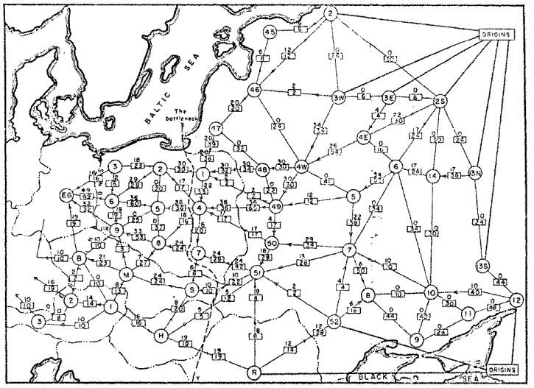
Network Flow
Question: What is the maximum throughput of the railroad network?
Railway map of Western USSR, 1955

Slide 2
Today’s Keywords
Max Flow, Min Cut
Reductions
Bipartite Matching
Vertex Cover
Independent Set
CLRS Chapter 34

Slide 3
Flow Network
3
2
Graph $G=(V,E)$
Source node $s∈V$
Sink node $t∈V$
Edge Capacities $c\left(e\right)∈$ Positive Real numbers
Max flow intuition: If $s$ is a faucet, $t$ is a drain, and $s$ connects to $t$ through a network of pipes with given capacities, what is the maximum amount of water which can flow from the faucet to the drain?
3
$$s$$
3
2
$$t$$
2
1
3
1
2
3

Slide 4
Flow
2/2
1/3
Assignment of values to edges
$f\left(e\right)=n$
Amount of water going through that pipe
Capacity constraint
$f\left(e\right)≤c(e)$
Flow cannot exceed capacity
Flow constraint
$∀v∈V−\{s,t\}$, $inflow\left(v\right)=outflow(v)$
$inflow\left(v\right)=\sum_{x∈V}{f(x,v)}$
$outflow\left(v\right)=\sum_{x∈V}{f(v,x)}$
Water going in must match water coming out
Flow of $G$: $|f|=outflow\left(s\right)−inflow(s)$
Net outflow of $s$
2/3
$$s$$
1/3
1/1
2/2
$$t$$
2/3
1/2
0/1
1/2
2/3
Flow/Capacity
3 in example above

Slide 5
Max Flow
Of all valid flows through the graph, find the one which maximizes:
$\left|f\right|=outflow\left(s\right)−inflow(s)$

Slide 6
Residual Graph $G_{f}$
Keep track of net available flow along each edge
Forward edges: weight is equal to available flow along that edge in the flow graph
$w\left(e\right)=c\left(e\right)−f(e)$
Back edges: weight is equal to flow along that edge in the flow graph
$w\left(e\right)=f(e)$
Flow I could add
Flow I could remove
Residual Graph $G_{f}$
Flow Graph $G$
1
2
1/3
a
2/2
a
0
2
2/3
2
$$s$$
1/3
1/1
$$s$$
1
1
1/2
$$t$$
1
2/2
2/3
2
0
3
$$t$$
0
2
3
1
1
0/1
b
1/2
b
1
2/3
2

Slide 7
Ford Fulkerson: example
Residual Graph $G_{f}$
Flow Graph $G$
0/3
0/2
0
0
0/3
2
$$s$$
3
0
0/3
0/1
0/2
0/2
$$t$$
$$s$$
0
3
0/3
0
3
1
2
$$t$$
2
3
0/1
0/2
2
0/3
1
0
3
0
Add flow of 1 to this path

Slide 8
Ford Fulkerson: example
Residual Graph $G_{f}$
Flow Graph $G$
1/3
1/2
1
1
0/3
1
$$s$$
2
0
0/3
1/1
0/2
0/2
$$t$$
$$s$$
1
3
0/3
0
3
0
2
$$t$$
2
3
0/1
1/2
1
1/3
1
1
2
1
Add flow of 1 to this path

Slide 9
Ford Fulkerson: example
Residual Graph $G_{f}$
Flow Graph $G$
1/3
1/2
1
1
1/3
1
$$s$$
2
1
0/3
0/1
1/2
0/2
$$t$$
$$s$$
0
2
0/3
0
3
1
2
$$t$$
1
3
0/1
1/2
1
1/3
2
1
2
1
Add flow of 1 to this path

Slide 10
Ford Fulkerson: example
Residual Graph $G_{f}$
Flow Graph $G$
2/3
2/2
2
2
2/3
0
$$s$$
1
2
0/3
0/1
1/2
0/2
$$t$$
$$s$$
0
1
0/3
0
3
1
2
$$t$$
1
3
0/1
1/2
1
1/3
2
1
2
1

Slide 11
Ford-Fulkerson Running Time
Define an augmenting path to be an $s→t$ path in the residual graph $G_{f }$ (using edges of non-zero weight)
Ford-Fulkerson max-flow algorithm:
Initialize $f\left(e\right)=0$ for all $e∈E$
Construct the residual network $G_{f}$
While there is an augmenting path $p$ in $G_{f}$:
Let $c=\min_{e∈E}{c_{f}(e)}$ ($c_{f}(e)$ is the weight of edge $e$ in the residual network $G_{f}$)
Add $c$ units of flow to $G$ based on the augmenting path $p$
Update the residual network $G_{f}$ for the updated flow
Initialization: $O\left(\left|E\right|\right)$

Slide 12
Ford-Fulkerson Running Time
Define an augmenting path to be an $s→t$ path in the residual graph $G_{f }$ (using edges of non-zero weight)
Ford-Fulkerson max-flow algorithm:
Initialize $f\left(e\right)=0$ for all $e∈E$
Construct the residual network $G_{f}$
While there is an augmenting path $p$ in $G_{f}$:
Let $c=\min_{e∈E}{c_{f}(e)}$ ($c_{f}(e)$ is the weight of edge $e$ in the residual network $G_{f}$)
Add $c$ units of flow to $G$ based on the augmenting path $p$
Update the residual network $G_{f}$ for the updated flow
Initialization: $O\left(\left|E\right|\right)$
Construct residual network: $O\left(\left|E\right|\right)$

Slide 13
Ford-Fulkerson Running Time
Define an augmenting path to be an $s→t$ path in the residual graph $G_{f }$ (using edges of non-zero weight)
Ford-Fulkerson max-flow algorithm:
Initialize $f\left(e\right)=0$ for all $e∈E$
Construct the residual network $G_{f}$
While there is an augmenting path $p$ in $G_{f}$:
Let $c=\min_{e∈E}{c_{f}(e)}$ ($c_{f}(e)$ is the weight of edge $e$ in the residual network $G_{f}$)
Add $c$ units of flow to $G$ based on the augmenting path $p$
Update the residual network $G_{f}$ for the updated flow
We only care about nodes reachable from the source $s$ (so the number of nodes that are “relevant” is at most $\left|E\right|$)
Initialization: $O\left(\left|E\right|\right)$
Construct residual network: $O\left(\left|E\right|\right)$
Finding augmenting path in residual network: $O\left(\left|E\right|\right)$ using BFS/DFS

Slide 14
Ford-Fulkerson Running Time
Define an augmenting path to be an $s→t$ path in the residual graph $G_{f }$ (using edges of non-zero weight)
Ford-Fulkerson max-flow algorithm:
Initialize $f\left(e\right)=0$ for all $e∈E$
Construct the residual network $G_{f}$
While there is an augmenting path $p$ in $G_{f}$:
Let $c=\min_{e∈E}{c_{f}(e)}$ ($c_{f}(e)$ is the weight of edge $e$ in the residual network $G_{f}$)
Add $c$ units of flow to $G$ based on the augmenting path $p$
Update the residual network $G_{f}$ for the updated flow
How many iterations are needed?
For integer-valued capacities, min-weight of each augmenting path is 1, so number of iterations is bounded by $\left|f^{∗}\right|$, where $\left|f^{∗}\right|$ is max-flow in $G$
For rational-valued capacities, can scale to make capacities integer
For irrational-valued capacities, algorithm may never terminate!
Initialization: $O\left(\left|E\right|\right)$
Construct residual network: $O\left(\left|E\right|\right)$
Finding augmenting path in residual network: $O\left(\left|E\right|\right)$ using BFS/DFS

Slide 15
Ford-Fulkerson Running Time
Define an augmenting path to be an $s→t$ path in the residual graph $G_{f }$ (using edges of non-zero weight)
Ford-Fulkerson max-flow algorithm:
Initialize $f\left(e\right)=0$ for all $e∈E$
Construct the residual network $G_{f}$
While there is an augmenting path $p$ in $G_{f}$:
Let $c=\min_{e∈E}{c_{f}(e)}$ ($c_{f}(e)$ is the weight of edge $e$ in the residual network $G_{f}$)
Add $c$ units of flow to $G$ based on the augmenting path $p$
Update the residual network $G_{f}$ for the updated flow
For graphs with integer capacities, running time of Ford-Fulkerson is
$$O\left(\left|f^{∗}\right|⋅\left|E\right|\right)$$
Highly undesirable if $\left|f^{∗}\right|≫|E|$ (e.g., graph is small, but capacities are $≈2^{32}$)
As described, algorithm is not polynomial-time!
Initialization: $O\left(\left|E\right|\right)$
Construct residual network: $O\left(\left|E\right|\right)$
Finding augmenting path in residual network: $O\left(\left|E\right|\right)$ using BFS/DFS

Slide 16
Worst-Case Ford-Fulkerson
0/100
0/100
100
100
$$s$$
0/1
$$t$$
$$s$$
1
$$t$$
0/100
0/100
100
100

Slide 17
Worst-Case Ford-Fulkerson
Increase flow by 1 unit
0/100
0/100
100
100
$$s$$
0/1
$$t$$
$$s$$
1
$$t$$
0/100
0/100
100
100

Slide 18
Worst-Case Ford-Fulkerson
Increase flow by 1 unit
1/100
0/100
100
100
$$s$$
1/1
$$t$$
$$s$$
1
$$t$$
0/100
1/100
100
100

Slide 19
Worst-Case Ford-Fulkerson
1/100
0/100
99
100
1
$$s$$
1/1
$$t$$
$$s$$
1
$$t$$
1
0/100
1/100
100
99

Slide 20
Worst-Case Ford-Fulkerson
Increase flow by 1 unit
1/100
0/100
99
100
1
$$s$$
1/1
$$t$$
$$s$$
1
$$t$$
1
0/100
1/100
100
99

Slide 21
Worst-Case Ford-Fulkerson
Increase flow by 1 unit
1/100
1/100
99
100
1
$$s$$
0/1
$$t$$
$$s$$
1
$$t$$
1
1/100
1/100
100
99

Slide 22
Worst-Case Ford-Fulkerson
1/100
1/100
99
99
1
1
$$s$$
0/1
$$t$$
$$s$$
1
$$t$$
1
1
1/100
1/100
99
99

Slide 23
Worst-Case Ford-Fulkerson
1/100
1/100
99
99
1
1
$$s$$
0/1
$$t$$
$$s$$
1
$$t$$
1
1
1/100
1/100
99
99
Observation: each iteration increases flow by 1 unit
Total number of iterations: $\left|f^{∗}\right|=200$

Slide 24
Can We Avoid this?
Edmonds-Karp Algorithm: choose augmenting path with fewest hops
Running time: $Θ\left(\min\left(\left|E\right|\left|f^{∗}\right|, \left|V\right|{\left|E\right|}^{2}\right)\right)=O\left(\left|V\right|{\left|E\right|}^{2}\right)$
How to find this?
Use breadth-first search (BFS)!
Edmonds-Karp = Ford-Fulkerson using BFS to find augmenting path
Ford-Fulkerson max-flow algorithm:
Initialize $f\left(e\right)=0$ for all $e∈E$
Construct the residual network $G_{f}$
While there is an augmenting path in $G_{f}$, let $p$ be the path with fewest hops:
Let $c=\min_{e∈E}{c_{f}(e)}$ ($c_{f}(e)$ is the weight of edge $e$ in the residual network $G_{f}$)
Add $c$ units of flow to $G$ based on the augmenting path $p$
Update the residual network $G_{f}$ for the updated flow
Proof: See CLRS (Chapter 26.2)

Slide 25
Showing Correctness of Ford-Fulkerson
Consider cuts which separate $s$ and $t$
Let $s∈S$, $t∈T$, s.t. $V=S∪T$
Cost of cut $\left(S,T\right)=|\left|S,T\right||$
Sum capacities of edges which go from $S$ to $T$
This example: 5
$$S$$
2
3
$$T$$
3
$$s$$
3
2
$$t$$
2
1
3
1
2
3

Slide 26
Maxflow$≤$MinCut
Max flow upper bounded by any cut separating $s$ and $t$
Why? “Conservation of flow”
All flow exiting $s$ must eventually get to $t$
To get from $s$ to $t$, all “tanks” must cross the cut
Conclusion: If we find the minimum-cost cut, we’ve found the maximum flow
$\max_{f}\left|f\right|≤\min_{S,T}{|\left|S,T\right||}$
$$S$$
2
3
$$T$$
3
$$s$$
3
2
$$t$$
2
1
3
1
2
3

Slide 27
Maxflow/Mincut Theorem
To show Ford-Fulkerson is correct:
Show that when there are no more augmenting paths, there is a cut with cost equal to the flow
Conclusion: the maximum flow through a network matches the minimum-cost cut
$\max_{f}\left|f\right|=\min_{S,T}{|\left|S,T\right||}$
Duality
When we’ve maximized max flow, we’ve minimized min cut (and vice-versa), so we can check when we’ve found one by finding the other

Slide 28
Example: Maxflow/Mincut
Flow Graph $G$
Residual Graph $G_{f}$
2
2
2/3
2/2
0
2
2/3
1
$$s$$
0/3
1/1
$$s$$
1
1
1/2
$$t$$
0
2/2
2/3
3
0
3
$$t$$
0
2
3
0
2
0/1
2/2
0
3/3
$$|f|= 4$$
3
No Augmenting Paths
$$\left|\left|S,T\right|\right|=4$$
Idea: When there are no more augmenting paths, there exists a cut in the graph with cost matching the flow
28

Slide 29
Proof: Maxflow/Mincut Theorem
If $|f|$ is a max flow, then $G_{f}$ has no augmenting path
Otherwise, use that augmenting path to “push” more flow
Define $S=$ nodes reachable from source node $s$ by positive-weight edges in the residual graph
$T=V−S$
$S$ separates $s$ , $t$ (otherwise there’s an augmenting path)
Residual Graph $G_{f}$
Flow Graph $G$
2
2
2/2
0
2
2/3
1
2/3
$$s$$
1
1
$$s$$
0/3
1/1
0
3
0
3
$$t$$
2/2
1/2
$$t$$
0
2
2/3
0
3
2
0/1
2/2
0
3/3
3

Slide 30
Proof: Maxflow/Mincut Theorem
To show: $\left|\left|S,T\right|\right|=|f|$
Weight of the cut matches the flow across the cut
Consider edge $(u,v)$ with $u∈S$, $v∈T$
$f\left(u,v\right)=c(u,v)$, because otherwise $w\left(u,v\right)>0$ in $G_{f}$, which would mean $v∈S$
Consider edge $(y,x)$ with $y∈T$, $x∈S$
$f\left(y,x\right)=0$, because otherwise the back edge $w\left(y,x\right)>0$ in $G_{f}$, which would mean $y∈S$
Residual Graph $G_{f}$
Flow Graph $G$
2
2
2/2
0
2
2/3
1
2/3
$$s$$
1
1
$$s$$
0/3
1/1
0
3
0
3
$$t$$
2/2
1/2
$$t$$
0
2
2/3
3
0
2
0/1
2/2
0
3/3
3

Slide 31
Proof Summary
The flow $|f|$ of $G$ is upper-bounded by the sum of capacities of edges crossing any cut separating source $s$ and sink $t$
When Ford-Fulkerson terminates, there are no more augmenting paths in $G_{f}$
When there are no more augmenting paths in $G_{f}$ then we can define a cut $S=$ nodes reachable from source node $s$ by positive-weight edges in the residual graph
The sum of edge capacities crossing this cut must match the flow of the graph
Therefore this flow is maximal

Slide 32
Divide and Conquer*
Divide:
Break the problem into multiple subproblems, each smaller instances of the original
Conquer:
If the suproblems are “large”:
Solve each subproblem recursively
If the subproblems are “small”:
Solve them directly (base case)
Combine:
Merge together solutions to subproblems
*CLRS Chapter 4

Slide 33
Dynamic Programming
Requires Optimal Substructure
Solution to larger problem contains the solutions to smaller ones
Idea:
Identify recursive structure of the problem
Select a good order for solving subproblems
Usually smallest problem first

Slide 34
Greedy Algorithms
Require Optimal Substructure
Solution to larger problem contains the solution to a smaller one
Only one subproblem to consider!
Idea:
Identify a greedy choice property
How to make a choice guaranteed to be included in some optimal solution
Repeatedly apply the choice property until no subproblems remain

Slide 35
So far
Divide and Conquer, Dynamic Programming, Greedy
Take an instance of Problem A, relate it to smaller instances of Problem A
Next:
Take an instance of Problem A, relate it to an instance of Problem B

Slide 36
Edge-Disjoint Paths
Given a graph $G=(V,E)$, a start node $s$ and a destination node $t$, give the maximum number of paths from $s$ to $t$ which share no edges
$$s$$
g
h
f
$$t$$
e
b
c
a

Slide 37
Edge-Disjoint Paths
Given a graph $G=(V,E)$, a start node $s$ and a destination node $t$, give the maximum number of paths from $s$ to $t$ which share no edges
$$s$$
g
Set of edge-disjoint paths of size 3
h
f
$$t$$
e
b
c
a

Slide 38
Edge-Disjoint Paths
Given a graph $G=(V,E)$, a start node $s$ and a destination node $t$, give the maximum number of paths from $s$ to $t$ which share no edges
$$s$$
g
Set of edge-disjoint paths of size 4
h
f
$$t$$
e
b
c
a

Slide 39
Edge-Disjoint Paths Algorithm
Make $s$ and $t$ the source and sink, give each edge capacity $1$, find the max flow.
1/1
$$s$$
g
Set of edge-disjoint paths of size 4
1/1
0/1
1/1
Max flow = 4
h
1/1
1/1
1/1
f
1/1
0/1
1/1
$$t$$
e
b
0/1
1/1
1/1
c
0/1
a
0/1

Slide 40
Vertex-Disjoint Paths
Given a graph $G=(V,E)$, a start node $s$ and a destination node $t$, give the maximum number of paths from $s$ to $t$ which share no vertices
$$s$$
g
h
f
$$t$$
e
b
c
a

Slide 41
Vertex-Disjoint Paths
Given a graph $G=(V,E)$, a start node $s$ and a destination node $t$, give the maximum number of paths from $s$ to $t$ which share no vertices
$$s$$
g
Not a vertex-disjoint path!
h
f
$$t$$
e
b
c
a

Slide 42
Vertex-Disjoint Paths Algorithm
Idea: Convert an instance of the vertex-disjoint paths problem into an instance of edge-disjoint paths
Make two copies of each node, one connected to incoming edges, the other to outgoing edges
Compute Edge-Disjoint Paths on new graph
$$s$$
g
Restricts to 1 edge
g in
g out
h
f
$$t$$
e
b
c
a

Slide 43
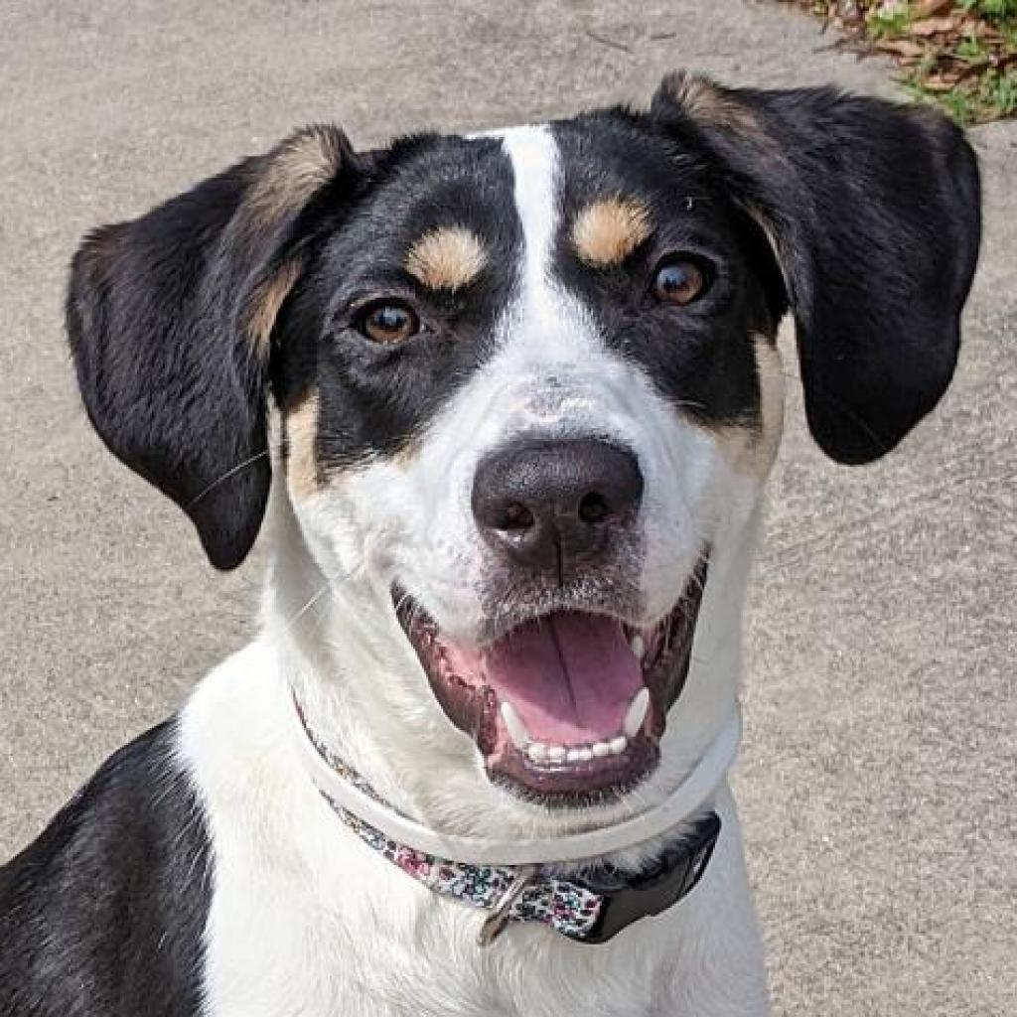
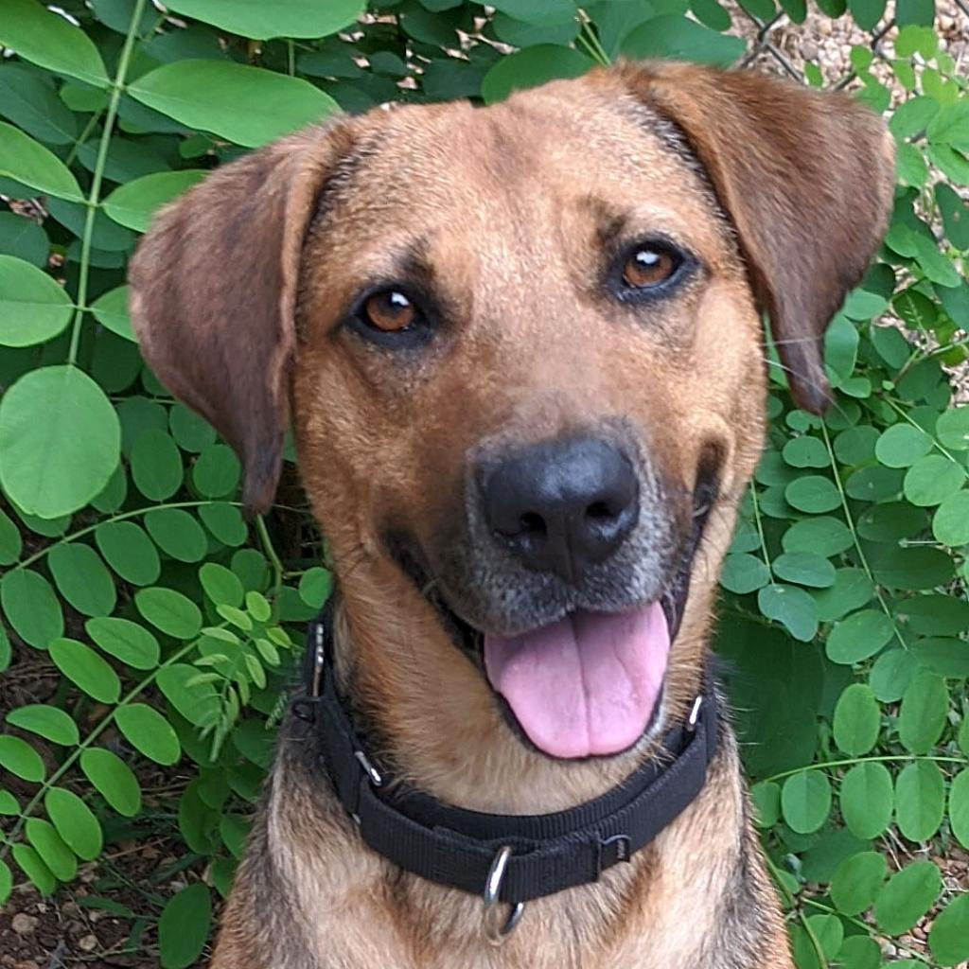
Maximum Bipartite Matching
Dog Lovers
Dogs

Slide 44
Maximum Bipartite Matching
Dog Lovers
Dogs

Slide 45
Maximum Bipartite Matching
Dog Lovers
Dogs

Slide 46
Maximum Bipartite Matching
Given a graph $G=\left(L,R,E\right)$
a set of left nodes, right nodes, and edges between left and right
Find the largest set of edges $M⊆E$ such that each node $u∈L$ or $v∈R$ is incident to at most one edge.

Slide 47
Maximum Bipartite Matching Using Max Flow
Make $G=(L,R,E)$ a flow network $G^{′}=(V^{′},E^{′})$ by:
Adding in a source and sink to the set of nodes:
$V^{′}=L∪R∪\{s,t\}$
Adding an edge from source to $L$ and from $R$ to sink:
$E^{′}=E∪\left\{u∈L \right| \left(s,u\right)\}∪\left\{v∈r \right| \left(v,t\right)\}$
Make each edge capacity $1$:
$∀e∈E^{′}, c\left(e\right)=1$
1
1
1
1
1
1
$$s$$
1
1
1
1
$$t$$
1
1
1
1
1
1
1

Slide 48
Maximum Bipartite Matching Using Max Flow
$$Θ(E⋅V)$$
Make $G$ into $G′$
Compute Max Flow on $G′$
Return $M$ as all “middle” edges with flow 1
$$Θ(L+R)$$
$$Θ(E⋅V)$$
$$\left|f\right|≤L$$
$$Θ(L+R)$$
0/1
1/1
0/1
1/1
1/1
1/1
$$s$$
1/1
0/1
1/1
0/1
$$t$$
1/1
1/1
1/1
1/1
1/1
1/1
0/1

Slide 49
Reductions
Algorithm technique of supreme ultimate power
Convert instance of problem A to an instance of Problem B
Convert solution of problem B back to a solution of problem A

Slide 50
Reductions
Shows how two different problems relate to each other
MOVIE TIME!

Slide 51
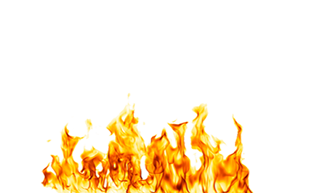
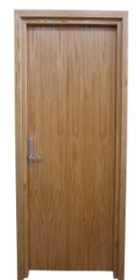
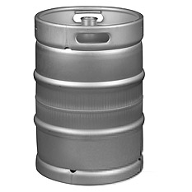
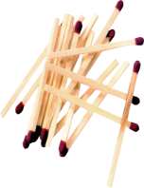
MacGyver’s Reduction
Problem we don’t know how to solve
Problem we do know how to solve
$$A$$
Opening a door
Aim duct at door, insert keg
Lighting a fire
$$B$$
How?
Solution for $A$
Solution for $B$
Keg cannon battering ram
Alcohol, wood, matches
Put fire under the Keg
Reduction

Slide 52
Bipartite Matching Reduction
Problem we don’t know how to solve
Problem we do know how to solve
Bipartite Matching
Max Flow
$$A$$
$$B$$
3
2
$$s$$
3
1
3
1
2
$$t$$
1
1
1
1
2
3
1
1
1
2
$$s$$
1
1
3
1
1
1
$$t$$
1
1
1
1
1
Ford Fulkerson
1/1
0/1
Solution for $A$
1/1
0/1
1/1
Solution for $B$
1/1
1/1
1/1
2
$$s$$
0/1
$$t$$
1
1/1
0/1
1/1
0
2
1/1
2
1/1
1
1/1
0/1
1/1
$$s$$
1
1
2
0
3
$$t$$
0
2
3
1
1
Must show (prove): 1) how to make construction
2) Why it works
1
Reduction
2

Slide 53
In General: Reduction
Problem we don’t know how to solve
Problem we do know how to solve
$$A$$
Map Instances of problem $A$to Instances of $B$
$$B$$
Injective: any instance of A can be mapped to some instance of B.
Using any Algorithm for $B$
Map Solutions of problem $B$to Solutions of $A$
Solution for $A$
Solution for $B$
$$X$$
$$Y$$
Reduction

Slide 54
Worst-case lower-bound Proofs
Opening a door
Lighting a fire
$$A$$
reduces to
$$B$$
Problem B
Problem A
Alcohol, wood, matches
can be used to make
Keg cannon battering ram
$$Y$$
$$X$$
Algorithm for B
Algorithm for A
$A$ is not a harder problem than $B$
$A≤B$
The name “reduces” is confusing: it is in the opposite direction of the making

Slide 55
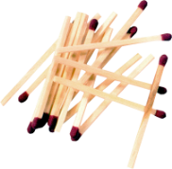
Proof of Lower Bound by Reduction
To Show: $Y$ is slow
$$X$$
1. We know X is slow (by a proof)
(e.g., X = some way to open the door)
$$Y$$
2. Assume Y is quick [toward contradiction]
(Y = some way to light a fire)
$$X$$
$$Y$$
3. Show how to use Y to perform X quickly
4. X is slow, but Y could be used to perform X quickly
conclusion: Y must not actually be quick

Slide 56
Reduction Proof Notation
$$A$$
$$B$$
$f(n)$-reduces to
Problem B
Problem A
$$Y$$
$$X$$
can be used to make
With $O(f\left(n\right))$ overhead
Algorithm for B
Algorithm for A
$A$ is not a harder problem than $B$
$A≤B$
If $A$ requires time $Ω(f\left(n\right))$ time then $B$ also requires $Ω(f\left(n\right))$ time
$A≤_{f(n)}B$

Slide 57
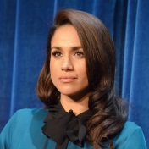
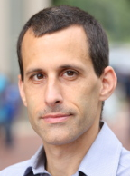
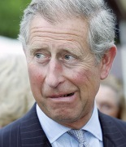
Party Problem
Draw Edges between people who don’t get along
Find the maximum number of people who get along

Slide 58
Maximum Independent Set
Independent set: $S⊆V$ is an independent set if no two nodes in $S$ share an edge
Maximum Independent Set Problem: Given a graph $G=(V,E)$ find the maximum independent set $S$

Slide 59
Example
Independent set of size 6

Slide 60
Generalized Baseball

Slide 61
Generalized Baseball
Need to place defenders on bases such that every edge is defended
What’s the fewest number of defenders needed?

Slide 62
Minimum Vertex Cover
Vertex Cover: $C⊆V$ is a vertex cover if every edge in $E$ has one of its endpoints in $C$
Minimum Vertex Cover: Given a graph $G=(V,E)$ find the minimum vertex cover $C$

Slide 63
Example
Vertex cover of size 5

Slide 64
MaxIndSet$≤_{V}$MinVertCov
$$A$$
$$B$$
$O(V)$-reduces to
Problem B
Problem A
$$Y$$
$$X$$
can be used to make
With $O(V)$ overhead
Algorithm for B
Algorithm for A
If $A$ requires time $Ω(f\left(n\right))$ time then $B$ also requires $Ω(f\left(n\right))$ time
$A≤_{V}B$

Slide 65
We need to build this Reduction
MaxIndSet
O(V) Time
MinVertCov
$$A$$
Relate Instances of MaxIndSet
to Instances of MinVertCov
$$B$$
Using any Algorithm for MinVertCov
Relate Solutions of MinVertCov to Solutions of MaxIndSet
Solution for MaxIndSet
Solution for MinVertCov
$$X$$
$$Y$$
Reduction

Slide 66
Reduction Idea
$S$ is an independent set of $G$ iff $V−S$ is a vertex cover of $G$
Independent Set
Vertex Cover

Slide 67
Reduction Idea
$S$ is an independent set of $G$ iff $V−S$ is a vertex cover of $G$
Vertex Cover
Independent Set

Slide 68
Proof: $⇒$
$S$ is an independent set of $G$ iff $V−S$ is a vertex cover of $G$
Let $S$ be an independent set
Consider any edge $\left(x,y\right)∈E$
If $x∈S$ then $y∉S$, because o.w. $S$ would not be an independent set
Therefore $y∈V−S$, so edge $(x,y)$ is covered by $V−S$

Slide 69
Proof: $⇐$
$S$ is an independent set of $G$ iff $V−S$ is a vertex cover of $G$
Let $V−S$ be a vertex cover
Consider any edge $\left(x,y\right)∈E$
At least one of $x$ and $y$ belong to $V−S$, because $V−S$ is a vertex cover
Therefore $x$ and $y$ are not both in $S$,
No edge has both end-nodes in $S$, thus $S$ is an independent set

Slide 70
MaxVertCov $V$-Time Reducable to MinIndSet
MaxIndSet
O(V) Time
MinVertCov
$$A$$
$$B$$
Do nothing
Using any Algorithm for MinVertCov
Solution for MaxIndSet
Take complement of solution
Solution for MinVertCov
$$X$$
$$Y$$
Reduction

Slide 71
MaxIndSet $V$-Time Reducable to MinVertCov
MaxIndSet
MinVertCov
O(V) Time
$$A$$
$$B$$
Do nothing
Using any Algorithm for MaxIndSet
Solution for MinVertCov
Take complement of solution
Solution for MaxIndSet
$$X$$
$$Y$$
Reduction

Slide 72
Corollary
MaxIndSet
O(V) Time
MinVertCov
$$A$$
$$B$$
Do nothing
Using any Algorithm for MinIndSet
If Solving $A$ was always slow
Then this shows solving $B$ is also slow
Solution for MaxIndSet
Take complement of solution
Solution for MinVertCov
$$X$$
$$Y$$
Reduction

Slide 73
Corollary
MaxIndSet
MinVertCov
O(V) Time
$$A$$
$$B$$
Do nothing
Using any Algorithm for MaxVertCov
If Solving $A$ was always slow
Then this shows solving $B$ is also slow
Solution for MinVertCov
Take complement of solution
Solution for MaxIndSet
$$X$$
$$Y$$
Reduction

Slide 74
Conclusion
MaxIndSet and MinVertCov are either both fast, or both slow
Spoiler alert: We don’t know which!
(But we think they’re both slow)
Both problems are NP-Complete
Next time!

