Slide 1
CS 4102, Algorithms Spring 2022
5th Lecture in Unit C Wrap up DP and Gerrymandering, then on to Greedy Algorithms!

Slide 2
Dynamic Programming and Gerrymandering
Let’s review / wrap-up a few things from the Gerrymandering lecture
Time-complexity
Pseudo-polynomial time-complexity for algorithms

Slide 3
Run Time
$$S\left(j,k,x,y\right)=S\left(j−1,k−1,x−R\left(p_{j}\right), y\right)∨S\left(j−1,k,x,y−R\left(p_{j}\right)\right)$$
Initialize $S(0,0,0,0)=$ True
for $j=1,…,n$:
for $k=1,…,min⁡(j,\frac{n}{2})$:
for $x=0,…,jm$:
for $y=0,…,jm$:
$S\left(j,k,x,y\right)=$
$$S\left(j−1,k−1,x−R\left(p_{j}\right), y\right)∨S\left(j−1,k,x,y−R\left(p_{j}\right)\right)$$
Search for True entry at $S(n,\frac{n}{2},>\frac{mn}{4},>\frac{mn}{4})$
$$n$$
$$\frac{n}{2}$$
$$Θ(n^{4}m^{2})$$
$$nm$$
$$nm$$

Slide 4
$$Θ(n^{4}m^{2})$$
This looks big! Yes, and it’s interesting too! ☺
Inputs:
List (size $n$) of precincts and counts of voters for Regular Party, $R\left(p_{i}\right)$
Number of voters (integer $m$)
$n$ is a size of one of the inputs
If $n$ doubles, twice as many items in the list that’s our input
But $m$is an input value (not a size)
If $m$ doubles, it’s still one integer, one input item
But the amount of work grows
The complexity depends on the size of this single integer

Slide 5
Size of a Numeric Input-Value
Question: How do we measure the size of an integer?
Answer: the number of bits to represent it.
Example: The value 4 (decimal) in binary is 100, so the size of “value 4” is 3.
If the size grows by 1, that’s 4 bits. With 4 bits, the value could be 1000 or 8 decimal.
Wait, what? Size of input grows by 1, and the value doubles (4 to 8). That sounds like exponential! $2^{n}$vs. $2^{n+1}$

Slide 6
Pseudo-Polynomial Time
Yes, the inputSize (in bits) of value $m$ is $\log_{2}{m}$ $inputSize{=log}_{2}{m}$
$m=2^{inputSize}$
So $m^{2}={{(2}^{inputSize})}^{2}$ = $2^{2∙inputSize}$
Gerrymandering’s run-time is exponential because of size of input $m$
Because run-time $Θ\left(n^{4}m^{2}\right)$ written in terms of the value of $m$, not the size of $m$
Input size is really $n+\left|m\right|=n+\log{m}$
This is called pseudo-polynomial time (https://en.wikipedia.org/wiki/Pseudo-polynomial_time)
We may see others like this! E.g. Coin-changing DP $Θ(k∙x)$and Knapsack DP $Θ(n∙C)$

Slide 7
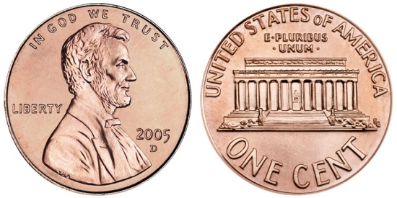
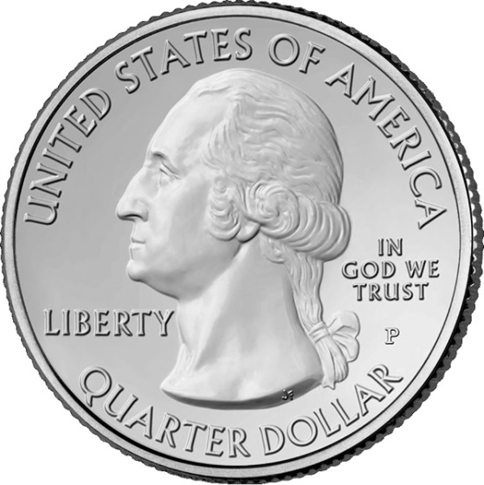
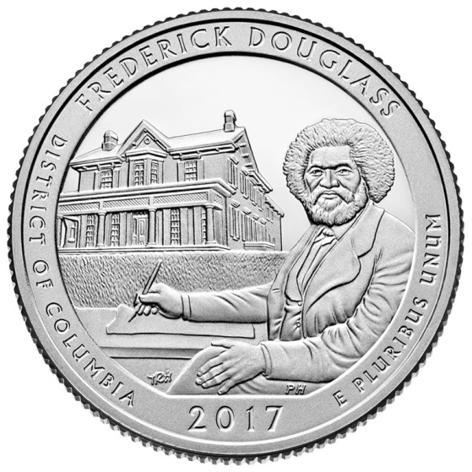
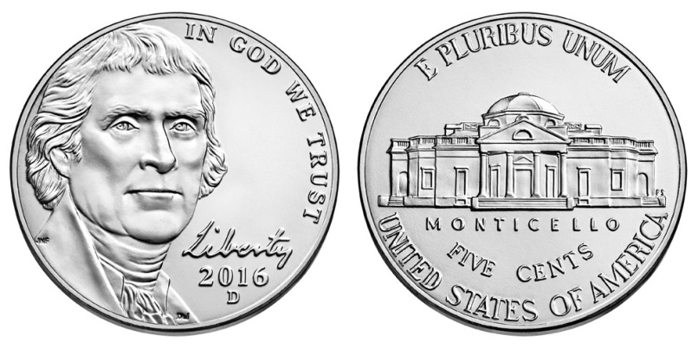
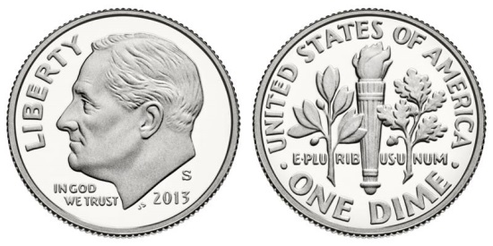
CS4102 Algorithms Spring 2022 –Hott and Horton
It’s time to “change” things up and start our unit on Greedy Algorithms! ☺

Slide 8
Where We’re Going
Terminology about optimization problems and greedy algorithms
Example 1: Coin Changing
Contrast with dynamic programming approach
Proofs of correctness
Example 2: Interval Scheduling
…
Textbook readings: CLRS Chapter 16 (go for it!)

Slide 9
Remember Our First Example?
Finding the correct change with minimum number of coins
Problem:
Give back the right amount of change, and…
Return the fewest number of coins!
Inputs: the dollar-amount to return
Also, the set of possible coins
Output: a set of coins
Let’s re-visit this with more detail

Slide 10
Coin Changing
Imagine a world without computerized cash registers!
The problem: Given an unlimited quantities of pennies, nickels, dimes, and quarters (worth value 1, 5, 10, 25 respectively), determine a set of coins (the change) for a given value $x$ using the fewest number of coins.

Slide 11
How Would You Solve This?
Would this be your algorithm?
Generate each possible set of coins that sum to x.
Determine which of these sets has the fewest coins.
No, this is probably not at all what you thought of doing!
It’s correct. But it’s a brute force approach.
What would you do?
Take a moment and try to describe your approach as an algorithm.

Slide 12
Change Making Algorithm
Given: target value $x$, list of coins $C=[c_{1}, …,c_{k}]$ (in this case $C=[1, 5, 10, 25]$)
Repeatedly select the largest coin less than the remaining target value:
while ($x>0$)
let $c=\max{{(c_{i}∈\{c}_{1}}, …,c_{k}\} | c_{i}≤x)$
add $c$ to solution
$x=x−c$
Observation: We can rewrite this to take $\left\lfloor n/c\right\rfloor$ copies of the next largest coin at each step, and reduce $x$ by $(c∙$ $\left\lfloor n/c\right\rfloor )$ Avoid call to max() by choosing next $c_{i}$ from largest to smallest. C must be sorted.

Slide 13
Let’s reflect on this
What’s its time-complexity?
Looks like it’s $O(x)$ in the worst-case. (Why do I say that?)
Maybe it’s $O(kx)$ if I really have to do a max() operation at each step
We’ll come back to this.
Does this always work? I.e. how can we prove it to be correct?
Intuitively you know it’s true for US coins, right?

Slide 14
Some Terminology Before We Continue…
Optimization problems: terminology
A solution must meet certain constraints: A solution is feasible
Example: All edges in solution are in graph, form a simple path.
Solutions judged on some criteria:
Objective function
Example: Sum of edge weights in path is smallest
One (or more) feasible solutions that scores highest (by the objective function) is called the optimal solution(s)
Both dynamic programming and the greedy approach are often good choices for optimization problems.

Slide 15
Greedy Strategy: An Overview
Greedy strategy:
Build solution by stages, adding one item to the partial solution we’ve found before this stage
At each stage, make locally optimal choice based on the greedy choice (sometimes called the greedy rule or the selection function)
Locally optimal, i.e. best given what info we have now
Irrevocable: a choice can’t be un-done
Sequence of locally optimal choices leads to globally optimal solution (hopefully)
Must prove this for a given problem!
Sometimes basis for approximation algorithms or heuristic algorithms used to get something close to optimal solution.

Slide 16
We’ve Seen Greedy Graph Algorithms
Dijkstra’s Shortest Path and Prim’s MST are greedy!
Build solution by adding item to partial solution
Dijkstra’s: add edge to connect kth vertex, where the edges for the k-1 already selected show the shortest paths to those k-1 vertices
Greedy choice
Dijkstra’s: for all vertices connected to one of the k-1 vertices processed, choose w where dist(s,w) is the minimum
We did have to prove that this sequence of locally optimal choices leads to globally optimal solution

Slide 17
Back to Coin Changing: Correctness?
Can you think of how you might argue this strategy (algorithm) always choose the optimal solution for coin-changing?
Maybe argue along these lines:
If an algorithm did something different than what our algorithm does, then it won’t choose optimal solution.
We’ll see proof later in slides.

Slide 18
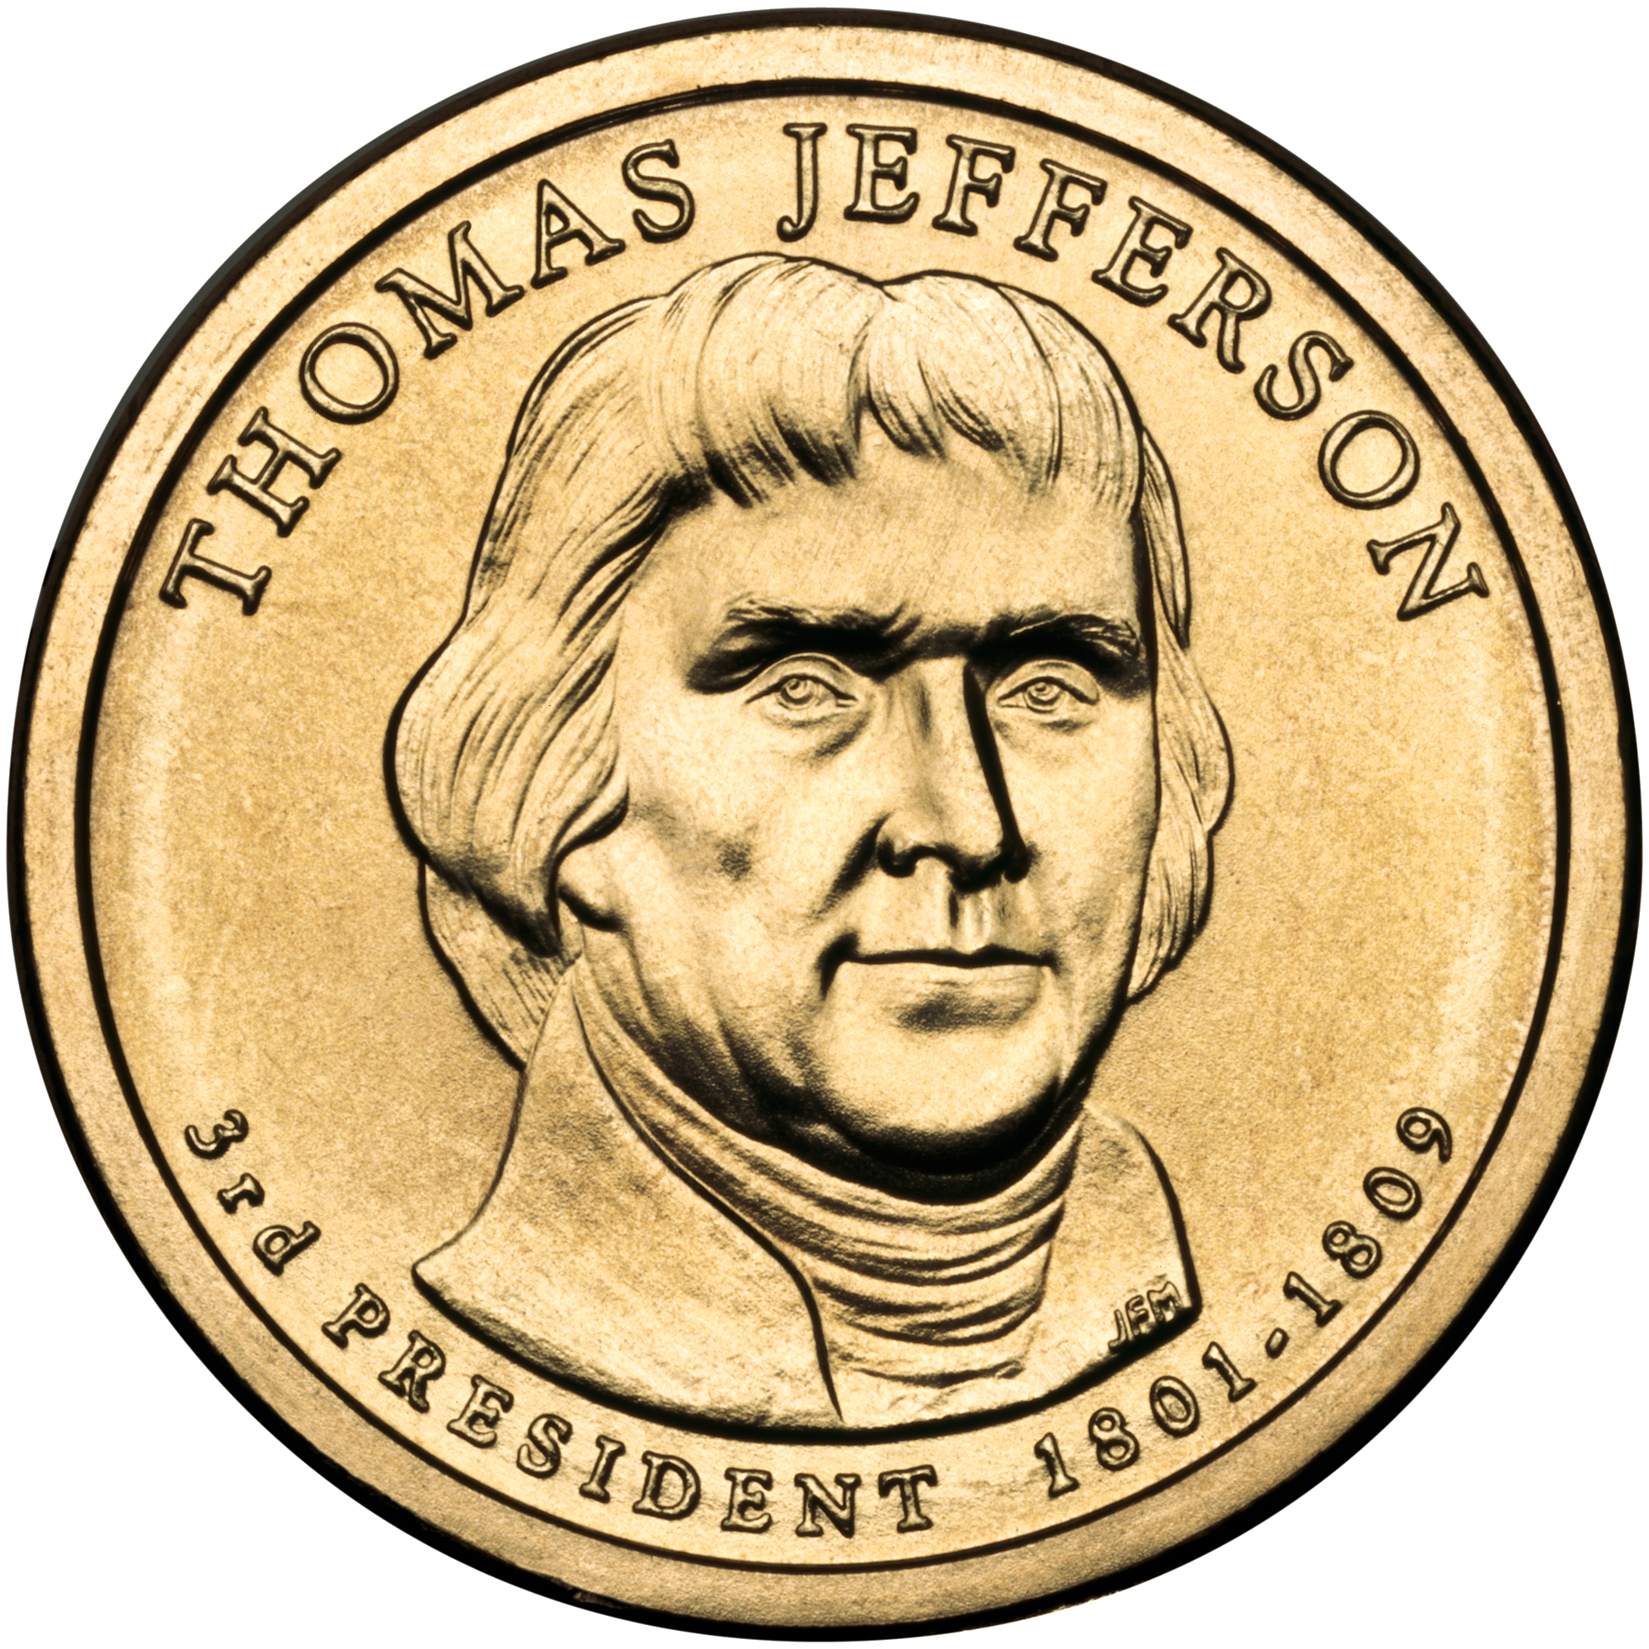
Warm Up, take 2
Given access to unlimited quantities of pennies, nickels, dimes, toms, and quarters (worth value 1, 5, 10, 11, 25 respectively), give 90 cents change using the fewest number of coins.
11 cents

Slide 19
Greedy method’s solution
90 cents
11 cents

Slide 20
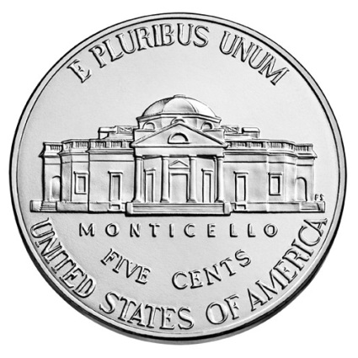
Greedy solution not optimal!
90 cents

Slide 21
Warm Up, take 2
Given access to unlimited quantities of pennies, nickels, dimes, toms, and quarters (worth value 1, 5, 10, 11, 25 respectively), give 90 cents change using the fewest number of coins.
We can solve coin changing with dynamic programming, too.
Will that work for this set of coins?
11 cents

Slide 22
Dynamic Programming
Requires Optimal Substructure
Optimal solution to a problem contains optimal solutions to subproblems
Idea:
Identify the recursive structure of the problem
What is the “last thing” done?
Save the solution to each subproblem in memory
Select a good order for solving subproblems
“Top Down”: Solve each recursively
“Bottom Up”: Iteratively solve smallest to largest

Slide 23
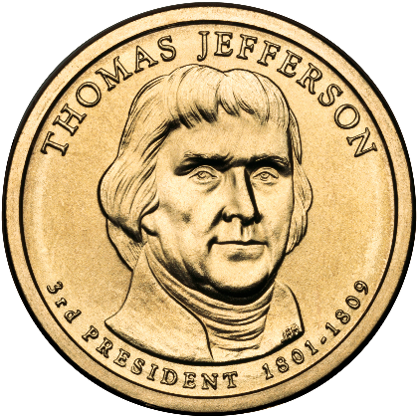
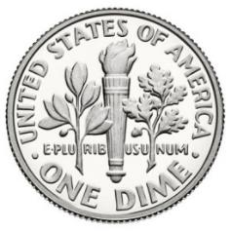
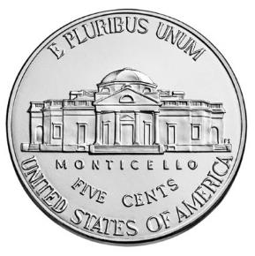
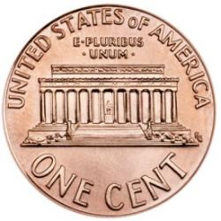
Identify Recursive Structure
$Change\left(x\right):$ minimum number of coins needed to give change for $x$ cents
Possibilities for last coin
Coins needed
$$Change\left(x−25\right)+1$$
if $x≥25$
Of course we need to define a data structure to remember partial results and fill it in some order. We won’t address that here.
$$Change\left(x−11\right)+1$$
if $x≥11$
$$Change\left(x−10\right)+1$$
if $x≥10$
$$Change\left(x−5\right)+1$$
if $x≥5$
$$Change\left(x−1\right)+1$$
if $x≥1$

Slide 24
Identify Recursive Structure
$Change\left(x\right):$ minimum number of coins needed to give change for $x$ cents
$$Change\left(x−25\right)+1$$
if $x≥25$
Correctness: The optimal solution must be contained in one of these configurations
$Change\left(x\right)=$ min
$$Change\left(x−11\right)+1$$
if $x≥11$
$$Change\left(x−10\right)+1$$
if $x≥10$
$$Change\left(x−5\right)+1$$
if $x≥5$
$$Change\left(x−1\right)+1$$
if $x≥1$
Size of input $x$ is how many bits to store $x$. Size $n=\lg{x}$ so $x=2^{\lg{x}}$, so $O\left(k{2^{n}}\right)$
Base Case: $Change\left(0\right)=0$
Running time: $O(kx)$
Is this efficient? Isn’t it polynomial?
$k$ is number of possible coins
No, this is pseudo-polynomial time

Slide 25
Greedy Change Making
Greedy approach: Only consider a single case/subproblem, which gives an asymptotically-better algorithm. When can we use the greedy approach?
Given: target value $x$, list of coins $C=[c_{1}, …,c_{k}]$ (in this case $C=[1, 5, 10, 25]$)
Greedy choice: Repeatedly select the largest coin less than the remaining target value:
while($x>0$)
let $c=\max{{(c_{i}∈\{c}_{1}}, …,c_{k}\} | c_{i}≤x)$
add $c$ to solution
$x=x−c$
Observation: We can rewrite this to take $\left\lfloor n/c\right\rfloor$ copies of the largest coin at each step.
Then loop over values $c_{i}$ from largest to smallest. Then if C is sorted….
Running time: $O(k)$
Polynomial-time!
$k$ is number of possible coins

Slide 26
Greedy vs DP
Dynamic Programming:
Require Optimal Substructure
Several choices for which small subproblem
Greedy:
Require Optimal Substructure
Must only consider one choice for small subproblem
Log Cutting:
Maximum profit for each last cut
Longest Common Subsequence:
Max length with same last character or with one or the other
Seam Carving:
Min energy seam that could connect with this pixel

Slide 27
Greedy Algorithms
Require Optimal Substructure
Optimal solution to a problem contains optimal solutions to subproblems
Only one subproblem to consider!
Idea:
Identify a greedy choice property
How to make a choice guaranteed to be included in some optimal solution
Repeatedly apply the choice property until no subproblems remain

Slide 28
Change Making Choice Property
Our algorithm’s Greedy choice: Choose largest coin less than or equal to target value
Leads to optimal solution?
For standard U.S. coins: Yes, coin chosen must be part of some optimal solution. We can prove it!
For “unusual” sets of coins? We saw a counter-example.
For U.S. postage stamps? Hmm…

Slide 29
Correctness of Greedy Algorithm
Optimal solution must satisfy following properties:
At most 4 pennies
At most 1 nickel
At most 2 dimes
Cannot contain 2 dimes and 1 nickel

Slide 30
Correctness of Greedy Algorithm
Claim: argue that at every step, greedy choice is part of some optimal solution
Case 1: Suppose $x<5$
Optimal solution must contain a penny (no other option available)
Greedy choice: penny
Case 2: Suppose $5≤x<10$
Optimal solution must contain a nickel
Suppose otherwise. Then optimal solution can only contain pennies (there are no other options), so it must contain $x>4$ pennies (contradiction)
Greedy choice: nickel
Case 3: Suppose $10≤x<25$
Optimal solution must contain a dime
Suppose otherwise. By construction, the optimal solution can contain at most 1 nickel, so there must be at least 6 pennies in the optimal solution (contradiction)
Greedy choice: dime

Slide 31
Correctness of Greedy Algorithm
Claim: argue that at every step, greedy choice is part of some optimal solution
Case 4: Suppose $25≤x$
Optimal solution must contain a quarter
Suppose otherwise. There are two possibilities for the optimal solution:
If it contains 2 dimes, then it can contain 0 nickels, in which case it contains at least 5 pennies (contradiction)
If it contains fewer than 2 dimes, then it can contain at most 1 nickel, so it must also contain at least 10 pennies (contradiction)
Greedy choice: quarter
Conclusion: in every case, the greedy choice is consistent with some optimal solution

Slide 32
Correctness of Greedy Algorithm
What about that 11-cent coin, the “tom”? How’s that break this proof?
Claim: argue that at every step, greedy choice is part of some optimal solution
Case 1: Suppose $n<5$
Optimal solution must contain a penny (no other option available)
Greedy choice: penny
Case 2: Suppose $5≤n<10$
Optimal solution must contain a nickel
Suppose otherwise. Then optimal solution can only contain pennies (there are no other options), so it must contain $n>4$ pennies (contradiction)
Greedy choice: nickel
Revised Case 3: Suppose $11≤x<25$
Optimal solution must contain a dime tom
Suppose otherwise. By construction, the optimal solution can contain at most 1 nickel, so there must be at least 6 pennies in the optimal solution (contradiction).
Greedy choice: dime tom
This argument no longer holds. Sometimes, it’s better to take the dime; other times, it’s better to take the 11-cent piece.
For 15: 1 tom + 4 pennies vs. 1 dime + 1 nickel.
For 12: 1 tom + 1 penny vs. 1 dime + 2 pennies

Slide 33
Wrap-up on Greedy basics
An approach to solving optimization problems
Finds optimal solution among set of feasible solutions
Problem must have optimal substructure property
Works in stages, applying greedy choice at each stage
Makes locally optimal choice, with goal of reaching overall optimal solution for entire problem
Proof needed to show correctness

Slide 34
Need more on Optimal Substructure Property?
Detailed discussion on p. 379 of CLRS (chapter on Dynamic Programming)
If A is an optimal solution to a problem, then the components of A are optimal solutions to subproblems
Another example: Shortest Path in graph problem
Say P is min-length path from CHO to LA and includes DAL
Let P₁ be component of P from CHO to DAL, and P₂ be component of P from DAL to LA
P₁ must be shortest path from CHO to DAL, and P₂ must be shortest path from DAL to LA
Why is this true? Can you prove it? Yes, by contradiction. (Try this at home!)

Slide 35
Next: Interval Scheduling
CLRS Section 16.1

Slide 36
Interval Scheduling
Input: List of events with their start and end times (sorted by end time)
Output: largest set of non-conflicting events (start time of each event is after the end time of all preceding events)
[1, 2.25] Lunch Zoom with friends
[2, 3.25] CS4102 Live Zoom session
[3, 4] Streaming department talk
[4, 5.25] Virtual Office hours
[4.5, 6] Zoom discussion section
[5, 7.5] Super Smash Brothers online game night
[7.75, 11] UVA Basketball Championship re-watch party

Slide 37
Interval Scheduling DP
$Best(t)=$ max # events that can be scheduled before time $t$
$$Best\left(s_{n}\right)+1$$
Include event $n$
$$Best\left(e_{n}\right)=max$$
$$Best\left(e_{n−1}\right)$$
Exclude event $n$
$$s_{1}$$
$$s_{2}$$
$$s_{n−1}$$
$$e_{2}$$
$$s_{n}$$
$$e_{n−1}$$
$$e_{n}$$

Slide 38
Greedy Interval Scheduling
Step 1: Identify a greedy choice property

Slide 39
Greedy Interval Scheduling
Step 1: Identify a greedy choice property
Options:
Shortest interval
Fewest conflicts
Earliest start
Earliest end
Prove using Exchange Argument

Slide 40
Interval Scheduling Algorithm
Find event ending earliest, add to solution,
Remove it and all conflicting events,
Repeat until all events removed, return solution

Slide 41
Interval Scheduling Algorithm
Find event ending earliest, add to solution,
Remove it and all conflicting events,
Repeat until all events removed, return solution

Slide 42
Interval Scheduling Algorithm
Find event ending earliest, add to solution,
Remove it and all conflicting events,
Repeat until all events removed, return solution

Slide 43
Interval Scheduling Algorithm
Find event ending earliest, add to solution,
Remove it and all conflicting events,
Repeat until all events removed, return solution

Slide 44
Interval Scheduling Run Time
Find event ending earliest, add to solution,
Remove it and all conflicting events,
Repeat until all events removed, return solution
Sort intervals by finish time
StartTime = 0
for each interval (in order of finish time):
if begin of interval > StartTime:
add interval to solution
StartTime = end of interval

Slide 45
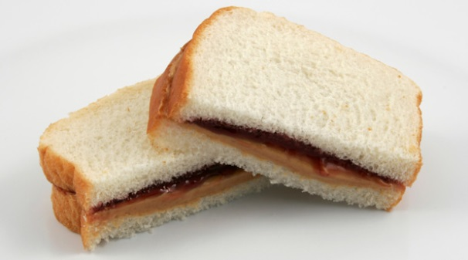
Exchange argument
Shows correctness of a greedy algorithm
Idea:
Show exchanging an item from an arbitrary optimal solution with your greedy choice makes the new solution no worse
How to show my sandwich is at least as good as yours:
Show: “I can remove any item from your sandwich, and it would be no worse by replacing it with the same item from my sandwich”

Slide 46
Exchange Argument for Earliest End Time

Slide 47
Exchange Argument for Earliest End Time
Claim: earliest ending interval is always part of some optimal solution
Let $OPT_{i,j}$ be an optimal solution for time range $[i,j]$
Let $a^{∗}$ be the first interval in $[i,j]$ to finish overall
If $a^{∗}∈OPT_{i,j}$ then claim holds
Else if $a^{∗}∉OPT_{i,j}$, let $a$ be the first interval to end in $OPT_{i,j}$
By definition $a^{∗}$ ends before $a$, and therefore does not conflict with any other events in $OPT_{i,j}$
Therefore $OPT_{i,j}−\{a\}+\{a^{∗}\}$ is also an optimal solution
Thus claim holds

