Slide 1
CS 4102: Algorithms – Unit C Dynamic Programming
Co-instructors: Robbie Hott and Tom Horton
Spring 2022

Slide 2
CS4102 Algorithms Spring 2022
Warm Up
How many arithmetic operations are required to multiply a $n×m$ matrix with a $m×p$ matrix?
(don’t overthink this)
$$p$$
$$m$$
$$n$$
$$×$$
$$m$$

Slide 3
Warm Up
How many arithmetic operations are required to multiply a $n×m$ Matrix with a $m×p$ Matrix?
(don’t overthink this)
$$p$$
$$m$$
$$p$$
$$n$$
$$×$$
$$m$$
$$=$$
$$n$$
$m$ multiplications and $m−1$ additions per element
$n⋅p$ elements to compute
Total cost: $O(m⋅n⋅p)$

Slide 4
Today’s Keywords
Dynamic Programming
Matrix Chaining

Slide 5
CLRS Readings
Chapter 15
Section 15.1, Log/Rod cutting, optimal substructure property
Note: r_{i} in book is called Cut() or C[] in our slides. We use their example.
Section 15.3, More on elements of DP, including optimal substructure property
Section 15.2, matrix-chain multiplication (later example)
Section 15.4, longest common subsequence (even later example)

Slide 6
Announcements
Updated Deadlines for Unit B
Exam rescheduled for March 29
Encouraged to submit early, Unit C assignments are coming soon

Slide 7
Dynamic Programming
Requires Optimal Substructure
Solution to larger problem contains the solutions to smaller ones
Or: If S is an optimal solution to a problem, then the components of S are optimal solutions to sub-problems
Idea:
Identify the recursive structure of the problem
What is the “last thing” done?
Save the solution to each subproblem in memory
Select a good order for solving subproblems
“Top Down”: Solve each recursively
“Bottom Up”: Iteratively solve smallest to largest

Slide 8
Generic Top-Down Dynamic Programming Soln
mem = {}
def myDPalgo(problem):
if mem[problem] not blank:
return mem[problem]
if baseCase(problem):
solution = solve(problem)
mem[problem] = solution
return solution
for subproblem of problem:
subsolutions.append(myDPalgo(subproblem))
solution = OptimalSubstructure(subsolutions)
mem[problem] = solution
return solution

Slide 9
Log Cutting Recursive Structure
$P\left[i\right]=$ value of a cut of length $i$
$Cut(n)=$ value of best way to cut a log of length $n$
$Cut\left(n−1\right)+P\left[1\right]$
$Cut\left(n−2\right)+P\left[2\right]$
$…$
$Cut\left(0\right)+P[n]$
$Cut\left(n\right)=max⁡$
$$Cut(n−ℓ_{n})$$
$$ℓ_{n}$$
best way to cut a log of length $n−ℓ_{n}$
Last Cut

Slide 10
Matrix Chaining
Given a sequence of Matrices $(M_{1}, …, M_{n})$, what is the most efficient way to multiply them?
$$c_{4}$$
$$c_{2}$$
$$M_{4}$$
$$c_{1}$$
$$M_{2}$$
$$c_{3}$$
$$M_{1}$$
$$M_{3}$$
$$r_{1}$$
$$×$$
$$r_{2}$$
$$×$$
$$r_{3}$$
$$×$$
$$r_{4}$$

Slide 11
Order Matters!
$$c_{1}=r_{2}$$
$$c_{2}=r_{3}$$
$$c_{2}$$
$$c_{3}$$
$$c_{1}$$
$$M_{2}$$
$$M_{3}$$
$$M_{1}$$
$$r_{1}$$
$$×$$
$$r_{2}$$
$$×$$
$$r_{3}$$
$$c_{2}$$
$$r_{1}$$
$\left(M_{1}×M_{2}\right)×M_{3}$
uses $\left(c_{1}⋅r_{1}⋅c_{2}\right)+c_{2}⋅r_{1}⋅c_{3}$ operations

Slide 12
Order Matters!
$$c_{2}$$
$$c_{3}$$
$$c_{1}=r_{2}$$
$$c_{2}=r_{3}$$
$$c_{1}$$
$$M_{2}$$
$$M_{3}$$
$$M_{1}$$
$$r_{1}$$
$$×$$
$$r_{2}$$
$$×$$
$$r_{3}$$
$$c_{3}$$
$$r_{2}$$
$M_{1}×(M_{2}×M_{3})$
uses $c_{1}⋅r_{1}⋅c_{3}+(c_{2}⋅r_{2}⋅c_{3})$ operations

Slide 13
Order Matters!
$$c_{1}=r_{2}$$
$$c_{2}=r_{3}$$
$\left(M_{1}×M_{2}\right)×M_{3}$
uses $\left(c_{1}⋅r_{1}⋅c_{2}\right)+c_{2}⋅r_{1}⋅c_{3}$ operations
$\left(10⋅7⋅20\right)+20⋅7⋅8=2520$
$M_{1}×(M_{2}×M_{3})$
uses $c_{1}⋅r_{1}⋅c_{3}+(c_{2}⋅r_{2}⋅c_{3})$ operations
$10⋅7⋅8+\left(20⋅10⋅8\right)=2160$
$$M_{1}=7×10$$
$$M_{2}=10×20$$
$$M_{3}=20×8$$
$$c_{1}=10$$
$$c_{2}=20$$
$$c_{3}=8$$
$$r_{1}=7$$
$$r_{2}=10$$
$$r_{3}=20$$

Slide 14
Dynamic Programming
Requires Optimal Substructure
Solution to larger problem contains the solutions to smaller ones
Idea:
Identify the recursive structure of the problem
What is the “last thing” done?
Save the solution to each subproblem in memory
Select a good order for solving subproblems
“Top Down”: Solve each recursively
“Bottom Up”: Iteratively solve smallest to largest

Slide 15
1. Identify the Recursive Structure of the Problem
$Best\left(1,n\right)=$ cheapest way to multiply together $M_{1}$ through $M_{n}$
$$c_{4}$$
$$c_{2}$$
$$M_{4}$$
$$c_{1}$$
$$M_{2}$$
$$c_{3}$$
$$M_{1}$$
$$M_{3}$$
$$r_{1}$$
$$×$$
$$r_{2}$$
$$×$$
$$r_{3}$$
$$×$$
$$r_{4}$$

Slide 16
1. Identify the Recursive Structure of the Problem
$Best\left(1,n\right)=$ cheapest way to multiply together $M_{1}$ through $M_{n}$
$$Best\left(2,4\right)+r_{1}r_{2}c_{4}$$
$$Best\left(1,4\right)=min$$
$$c_{4}$$
$$r_{2}$$
$$c_{4}$$
$$c_{2}$$
$$M_{4}$$
$$c_{1}$$
$$M_{2}$$
$$c_{3}$$
$$M_{1}$$
$$M_{3}$$
$$r_{1}$$
$$×$$
$$r_{2}$$
$$×$$
$$r_{3}$$
$$×$$
$$r_{4}$$

Slide 17
1. Identify the Recursive Structure of the Problem
$Best\left(1,n\right)=$ cheapest way to multiply together $M_{1}$ through $M_{n}$
$$Best\left(2,4\right)+r_{1}r_{2}c_{4}$$
$$Best\left(1,4\right)=min$$
$$Best\left(1,2\right)+Best\left(3, 4\right)+r_{1}r_{3}c_{4}$$
$$c_{2}$$
$$c_{4}$$
$$r_{3}$$
$$r_{1}$$
$$c_{4}$$
$$c_{2}$$
$$M_{4}$$
$$c_{1}$$
$$M_{2}$$
$$c_{3}$$
$$M_{1}$$
$$M_{3}$$
$$r_{1}$$
$$×$$
$$r_{2}$$
$$×$$
$$r_{3}$$
$$×$$
$$r_{4}$$

Slide 18
1. Identify the Recursive Structure of the Problem
$Best\left(1,n\right)=$ cheapest way to multiply together $M_{1}$ through $M_{n}$
$$Best\left(2,4\right)+r_{1}r_{2}c_{4}$$
$$Best\left(1,4\right)=min$$
$$Best\left(1,2\right)+Best\left(3, 4\right)+r_{1}r_{3}c_{4}$$
$$Best\left(1,3\right)+r_{1}r_{4}c_{4}$$
$$c_{3}$$
$$r_{1}$$
$$c_{4}$$
$$c_{2}$$
$$M_{4}$$
$$c_{1}$$
$$M_{2}$$
$$c_{3}$$
$$M_{1}$$
$$M_{3}$$
$$r_{1}$$
$$×$$
$$r_{2}$$
$$×$$
$$r_{3}$$
$$×$$
$$r_{4}$$

Slide 19
1. Identify the Recursive Structure of the Problem
In general:
$Best\left(i,j\right)=$ cheapest way to multiply together $M_{i}$ through $M_{j}$
$$Best\left(i,j\right)=\underset{k=i}{\overset{j−1}{min}}\left(Best\left(i,k\right)+Best\left(k+1, j\right)+r_{i}r_{k+1}c_{j}\right)$$
$$Best\left(i,i\right)=0$$
$$Best\left(2,n\right)+r_{1}r_{2}c_{n}$$
$$Best\left(1,2\right)+Best\left(3, n\right)+r_{1}r_{3}c_{n}$$
$$Best\left(1,3\right)+Best\left(4, n\right)+r_{1}r_{4}c_{n}$$
$$Best\left(1,n\right)=min$$
$$Best\left(1,4\right)+Best\left(5, n\right)+r_{1}r_{5}c_{n}$$
$$…$$
$$Best\left(1,n−1\right)+r_{1}r_{n}c_{n}$$

Slide 20
Dynamic Programming
Requires Optimal Substructure
Solution to larger problem contains the solutions to smaller ones
Idea:
Identify the recursive structure of the problem
What is the “last thing” done?
Save the solution to each subproblem in memory
Select a good order for solving subproblems
“Top Down”: Solve each recursively
“Bottom Up”: Iteratively solve smallest to largest

Slide 21
2. Save Subsolutions in Memory
In general:
$Best\left(i,j\right)=$ cheapest way to multiply together $M_{i}$ through $M_{j}$
$$Best\left(i,j\right)=\underset{k=i}{\overset{j−1}{min}}\left(Best\left(i,k\right)+Best\left(k+1, j\right)+r_{i}r_{k+1}c_{j}\right)$$
$$Best\left(i,i\right)=0$$
Read from M[n]
if present
Save to M[n]
$$Best\left(2,n\right)+r_{1}r_{2}c_{n}$$
$$Best\left(1,2\right)+Best\left(3, n\right)+r_{1}r_{3}c_{n}$$
$$Best\left(1,3\right)+Best\left(4, n\right)+r_{1}r_{4}c_{n}$$
$$Best\left(1,n\right)=min$$
$$Best\left(1,4\right)+Best\left(5, n\right)+r_{1}r_{5}c_{n}$$
$$…$$
$$Best\left(1,n−1\right)+r_{1}r_{n}c_{n}$$

Slide 22
Dynamic Programming
Requires Optimal Substructure
Solution to larger problem contains the solutions to smaller ones
Idea:
Identify the recursive structure of the problem
What is the “last thing” done?
Save the solution to each subproblem in memory
Select a good order for solving subproblems
“Top Down”: Solve each recursively
“Bottom Up”: Iteratively solve smallest to largest

Slide 23
3. Select a good order for solving subproblems
In general:
$Best\left(i,j\right)=$ cheapest way to multiply together $M_{i}$ through $M_{j}$
$$Best\left(i,j\right)=\underset{k=i}{\overset{j−1}{min}}\left(Best\left(i,k\right)+Best\left(k+1, j\right)+r_{i}r_{k+1}c_{j}\right)$$
$$Best\left(i,i\right)=0$$
Read from M[n]
if present
Save to M[n]
$$Best\left(2,n\right)+r_{1}r_{2}c_{n}$$
$$Best\left(1,2\right)+Best\left(3, n\right)+r_{1}r_{3}c_{n}$$
$$Best\left(1,3\right)+Best\left(4, n\right)+r_{1}r_{4}c_{n}$$
$$Best\left(1,n\right)=min$$
$$Best\left(1,4\right)+Best\left(5, n\right)+r_{1}r_{5}c_{n}$$
$$…$$
$$Best\left(1,n−1\right)+r_{1}r_{n}c_{n}$$

Slide 24
3. Select a good order for solving subproblems
$$35$$
$$15$$
$$5$$
$$10$$
$$20$$
$$25$$
$$M_{1}$$
$$M_{2}$$
$$M_{3}$$
$$M_{4}$$
$$M_{5}$$
$$M_{6}$$
$$30$$
$$×$$
$$35$$
$$×$$
$$15$$
$$×$$
$$5$$
$$×$$
$$10$$
$$×$$
$$20$$
$$Best\left(i,j\right)=\underset{k=i}{\overset{j−1}{min}}\left(Best\left(i,k\right)+Best\left(k+1, j\right)+r_{i}r_{k+1}c_{j}\right)$$
$$j=$$
$$1$$
$$2$$
$$3$$
$$4$$
$$5$$
$$6$$
$$=i$$
$$Best\left(i,i\right)=0$$
0
$$1$$
0
$$2$$
0
$$3$$
0
$$4$$
0
$$5$$
0
$$6$$

Slide 25
3. Select a good order for solving subproblems
$$35$$
$$15$$
$$5$$
$$10$$
$$20$$
$$25$$
$$M_{1}$$
$$M_{2}$$
$$M_{3}$$
$$M_{4}$$
$$M_{5}$$
$$M_{6}$$
$$30$$
$$×$$
$$35$$
$$×$$
$$15$$
$$×$$
$$5$$
$$×$$
$$10$$
$$×$$
$$20$$
$$Best\left(i,j\right)=\underset{k=i}{\overset{j−1}{min}}\left(Best\left(i,k\right)+Best\left(k+1, j\right)+r_{i}r_{k+1}c_{j}\right)$$
$$j=$$
$$1$$
$$2$$
$$3$$
$$4$$
$$5$$
$$6$$
$$=i$$
$$Best\left(i,i\right)=0$$
0
15750
$$1$$
0
$$2$$
0
$$3$$
0
$$4$$
$$Best\left(1,1\right)+Best\left(2, 2\right)+r_{1}r_{2}c_{2}$$
0
$$5$$
$$Best\left(1,2\right)=min$$
0
$$6$$

Slide 26
3. Select a good order for solving subproblems
$$35$$
$$15$$
$$5$$
$$10$$
$$20$$
$$25$$
$$M_{1}$$
$$M_{2}$$
$$M_{3}$$
$$M_{4}$$
$$M_{5}$$
$$M_{6}$$
$$30$$
$$×$$
$$35$$
$$×$$
$$15$$
$$×$$
$$5$$
$$×$$
$$10$$
$$×$$
$$20$$
$$Best\left(i,j\right)=\underset{k=i}{\overset{j−1}{min}}\left(Best\left(i,k\right)+Best\left(k+1, j\right)+r_{i}r_{k+1}c_{j}\right)$$
$$j=$$
$$1$$
$$2$$
$$3$$
$$4$$
$$5$$
$$6$$
$$=i$$
$$Best\left(i,i\right)=0$$
0
15750
$$1$$
0
2625
$$2$$
0
$$3$$
0
$$4$$
$$Best\left(2,2\right)+Best\left(3, 3\right)+r_{2}r_{3}c_{3}$$
0
$$5$$
$$Best\left(2,3\right)=min$$
0
$$6$$

Slide 27
3. Select a good order for solving subproblems
$$35$$
$$15$$
$$5$$
$$10$$
$$20$$
$$25$$
$$M_{1}$$
$$M_{2}$$
$$M_{3}$$
$$M_{4}$$
$$M_{5}$$
$$M_{6}$$
$$30$$
$$×$$
$$35$$
$$×$$
$$15$$
$$×$$
$$5$$
$$×$$
$$10$$
$$×$$
$$20$$
$$Best\left(i,j\right)=\underset{k=i}{\overset{j−1}{min}}\left(Best\left(i,k\right)+Best\left(k+1, j\right)+r_{i}r_{k+1}c_{j}\right)$$
$$j=$$
$$1$$
$$2$$
$$3$$
$$4$$
$$5$$
$$6$$
$$=i$$
$$Best\left(i,i\right)=0$$
0
15750
$$1$$
0
2625
$$2$$
0
750
$$3$$
0
1000
$$4$$
0
5000
$$5$$
0
$$6$$

Slide 28
3. Select a good order for solving subproblems
$$35$$
$$15$$
$$5$$
$$10$$
$$20$$
$$25$$
$$M_{1}$$
$$M_{2}$$
$$M_{3}$$
$$M_{4}$$
$$M_{5}$$
$$M_{6}$$
$$30$$
$$×$$
$$35$$
$$×$$
$$15$$
$$×$$
$$5$$
$$×$$
$$10$$
$$×$$
$$20$$
$$Best\left(i,j\right)=\underset{k=i}{\overset{j−1}{min}}\left(Best\left(i,k\right)+Best\left(k+1, j\right)+r_{i}r_{k+1}c_{j}\right)$$
$$j=$$
$$1$$
$$2$$
$$3$$
$$4$$
$$5$$
$$6$$
$$=i$$
$$Best\left(i,i\right)=0$$
0
15750
7875
$$1$$
$$r_{1}r_{2}c_{3}=30⋅35⋅5=5250$$
0
2625
$$2$$
$$r_{1}r_{3}c_{3}=30⋅15⋅5=2250$$
0
750
$$3$$
0
1000
$$4$$
$$0$$
$$2625$$
$$Best\left(1,1\right)+Best\left(2, 3\right)+r_{1}r_{2}c_{3}$$
0
5000
$$5$$
$$Best\left(1,3\right)=min$$
$$Best\left(1,2\right)+Best\left(3, 3\right)+r_{1}r_{3}c_{3}$$
0
$$6$$
$$15750$$
$$0$$

Slide 29
3. Select a good order for solving subproblems
$$35$$
$$15$$
$$5$$
$$10$$
$$20$$
$$25$$
$$M_{1}$$
$$M_{2}$$
$$M_{3}$$
$$M_{4}$$
$$M_{5}$$
$$M_{6}$$
$$30$$
$$×$$
$$35$$
$$×$$
$$15$$
$$×$$
$$5$$
$$×$$
$$10$$
$$×$$
$$20$$
$$Best\left(i,j\right)=\underset{k=i}{\overset{j−1}{min}}\left(Best\left(i,k\right)+Best\left(k+1, j\right)+r_{i}r_{k+1}c_{j}\right)$$
$$j=$$
$$1$$
$$2$$
$$3$$
$$4$$
$$5$$
$$6$$
$$=i$$
$$Best\left(i,i\right)=0$$
0
15750
7875
$$1$$
0
2625
$$2$$
To find $Best(i,j)$: Need all preceding terms of row $i$ and column $j$
0
750
$$3$$
0
1000
$$4$$
Conclusion: solve in order of diagonal
0
5000
$$5$$
0
$$6$$

Slide 30
Matrix Chaining
$$35$$
$$15$$
$$5$$
$$10$$
$$20$$
$$25$$
$$M_{1}$$
$$M_{2}$$
$$M_{3}$$
$$M_{4}$$
$$M_{5}$$
$$M_{6}$$
$$30$$
$$×$$
$$35$$
$$×$$
$$15$$
$$×$$
$$5$$
$$×$$
$$10$$
$$×$$
$$20$$
$$Best\left(i,j\right)=\underset{k=i}{\overset{j−1}{min}}\left(Best\left(i,k\right)+Best\left(k+1, j\right)+r_{i}r_{k+1}c_{j}\right)$$
$$j=$$
$$1$$
$$2$$
$$3$$
$$4$$
$$5$$
$$6$$
$$=i$$
$$Best\left(i,i\right)=0$$
0
15750
7875
9375
11875
$$15125$$
$$1$$
0
2625
4375
7125
10500
$$2$$
0
750
2500
5375
$$3$$
$$Best\left(1,1\right)+Best\left(2, 6\right)+r_{1}r_{2}c_{6}$$
0
1000
3500
$$4$$
$$Best\left(1,2\right)+Best\left(3, 6\right)+r_{1}r_{3}c_{6}$$
$$Best\left(1,6\right)=min$$
$$Best\left(1,3\right)+Best\left(4, 6\right)+r_{1}r_{4}c_{6}$$
0
5000
$$5$$
$$Best\left(1,4\right)+Best\left(5, 6\right)+r_{1}r_{5}c_{6}$$
0
$$Best\left(1,5\right)+Best\left(6, 6\right)+r_{1}r_{6}c_{6}$$
$$6$$

Slide 31
Run Time
Initialize $Best[i,i]$ to be all 0s
Starting at the main diagonal, working to the upper-right, fill in each cell using:
$Best\left[i,i\right]=0$
$Best\left[i,j\right]=\underset{k=i}{\overset{j−1}{min}}\left(Best\left(i,k\right)+Best\left(k+1, j\right)+r_{i}r_{k+1}c_{j}\right)$
$Θ(n^{2})$ cells in the Array
Each “call” to Best() is a O(1) memory lookup
$Θ(n)$ options for each cell
$Θ(n^{3})$ overall run time

Slide 32
Backtrack to find the best order
“remember” which choice of $k$ was the minimum at each cell
$$Best\left(i,j\right)=\underset{k=i}{\overset{j−1}{min}}\left(Best\left(i,k\right)+Best\left(k+1, j\right)+r_{i}r_{k+1}c_{j}\right)$$
$$j=$$
$$1$$
$$2$$
$$3$$
$$4$$
$$5$$
$$6$$
$$=i$$
$$Best\left(i,i\right)=0$$
0
15750
7875
9375
11875
$$15125$$
$$1$$
$$1$$
$$3$$
0
2625
4375
7125
10500
$$2$$
0
750
2500
5375
$$3$$
$$Best\left(1,1\right)+Best\left(2, 6\right)+r_{1}r_{2}c_{6}$$
0
1000
3500
$$4$$
$$Best\left(1,2\right)+Best\left(3, 6\right)+r_{1}r_{3}c_{6}$$
$$5$$
$$Best\left(1,6\right)=min$$
$$Best\left(1,3\right)+Best\left(4, 6\right)+r_{1}r_{4}c_{6}$$
0
5000
$$5$$
$$Best\left(1,4\right)+Best\left(5, 6\right)+r_{1}r_{5}c_{6}$$
0
$$Best\left(1,5\right)+Best\left(6, 6\right)+r_{1}r_{6}c_{6}$$
$$6$$
32

Slide 33
Matrix Chaining
$$35$$
$$15$$
$$5$$
$$10$$
$$20$$
$$25$$
$$M_{1}$$
$$M_{2}$$
$$M_{3}$$
$$M_{4}$$
$$M_{5}$$
$$M_{6}$$
$$30$$
$$×$$
$$35$$
$$×$$
$$15$$
$$×$$
$$5$$
$$×$$
$$10$$
$$×$$
$$20$$
$$Best\left(i,j\right)=\underset{k=i}{\overset{j−1}{min}}\left(Best\left(i,k\right)+Best\left(k+1, j\right)+r_{i}r_{k+1}c_{j}\right)$$
$$j=$$
$$1$$
$$2$$
$$3$$
$$4$$
$$5$$
$$6$$
$$=i$$
$$Best\left(i,i\right)=0$$
0
15750
7875
9375
11875
$$15125$$
$$1$$
$$1$$
$$3$$
0
2625
4375
7125
10500
$$2$$
0
750
2500
5375
$$3$$
$$Best\left(1,1\right)+Best\left(2, 6\right)+r_{1}r_{2}c_{6}$$
0
1000
3500
$$4$$
$$Best\left(1,2\right)+Best\left(3, 6\right)+r_{1}r_{3}c_{6}$$
$$5$$
$$Best\left(1,6\right)=min$$
$$Best\left(1,3\right)+Best\left(4, 6\right)+r_{1}r_{4}c_{6}$$
0
5000
$$5$$
$$Best\left(1,4\right)+Best\left(5, 6\right)+r_{1}r_{5}c_{6}$$
0
$$Best\left(1,5\right)+Best\left(6, 6\right)+r_{1}r_{6}c_{6}$$
$$6$$

Slide 34
Storing and Recovering Optimal Solution
Maintain table Choice[i,j] in addition to Best table
Choice[i,j] = k means the best “split” was right after M_{k}
Work backwards from value for whole problem, Choice[1,n]
Note: Choice[i,i+1] = i because there are just 2 matrices
From our example:
Choice[1,6] = 3. So [M₁ M₂ M₃] [M₄ M₅ M₆]
We then need Choice[1,3] = 1. So [(M₁) (M₂ M₃)]
Also need Choice[4,6] = 5. So [(M₄ M₅) M₆]
Overall: [(M₁) (M₂ M₃)] [(M₄ M₅) M₆]

Slide 35
Dynamic Programming
Requires Optimal Substructure
Solution to larger problem contains the solutions to smaller ones
Or: If S is an optimal solution to a problem, then the components of S are optimal solutions to sub-problems
Idea:
Identify the recursive structure of the problem
What is the “last thing” done?
Save the solution to each subproblem in memory
Select a good order for solving subproblems
“Top Down”: Solve each recursively
“Bottom Up”: Iteratively solve smallest to largest

Slide 36
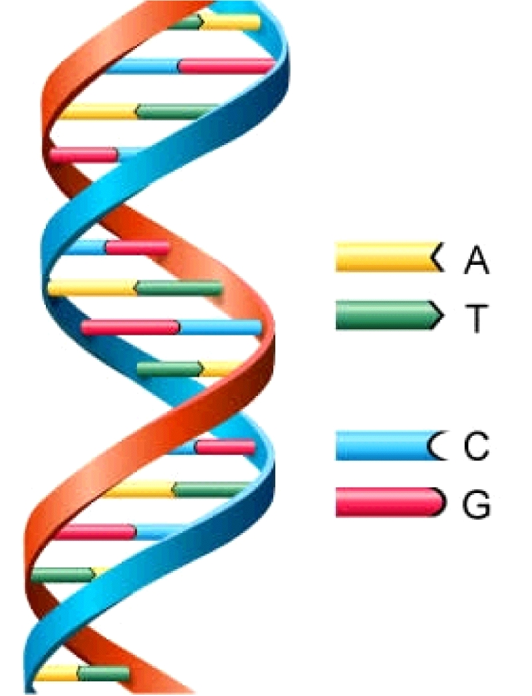
Longest Common Subsequence
Given two sequences $X$ and $Y$, find the length of their longest common subsequence
Example:
$X=ATCTGAT$
$Y=TGCATA$
$LCS=TCTA$
Brute force: Compare every subsequence of $X$ with $Y$
$Ω(2^{n})$
Applications other than bioinformatics?
Of course, Including version control!
http://cbx33.github.io/gitt/afterhours3-1.html

Slide 37
Dynamic Programming
Requires Optimal Substructure
Solution to larger problem contains the solutions to smaller ones
Idea:
Identify the recursive structure of the problem
What is the “last thing” done?
Save the solution to each subproblem in memory
Select a good order for solving subproblems
“Top Down”: Solve each recursively
“Bottom Up”: Iteratively solve smallest to largest

Slide 38
1. Identify Recursive Structure
Let $LCS\left(i,j\right)=$ length of the LCS for the first $i$ characters of $X$, first $j$ character of $Y$
Find $LCS(i,j)$:
Case 1: $X\left[i\right]=Y[j]$
$X=\text{A}\text{TCT}\text{GCG}\text{T}$
$Y=TGCATA\text{T}$
$$LCS\left(i,j\right)=LCS\left(i−1, j−1\right)+1$$
Case 2: $X\left[i\right]≠Y[j]$
X = ATCTGCGA
Y = TGCATAC
X = ATCTGCGA
Y = TGCATAC
$LCS\left(i,j\right)=LCS\left(i,j−1\right)$
$LCS\left(i,j\right)=LCS\left(i−1,j\right)$
$0$ if $i=0$ or $j=0$
$LCS\left(i−1,j−1\right)+1$ if $X\left[i\right]=Y[j]$
$\max{(LCS\left(i,j−1\right),LCS\left(i−1,j\right))}$ otherwise
$$LCS\left(i,j\right)=$$

Slide 39
Dynamic Programming
Requires Optimal Substructure
Solution to larger problem contains the solutions to smaller ones
Idea:
Identify the recursive structure of the problem
What is the “last thing” done?
Save the solution to each subproblem in memory
Select a good order for solving subproblems
“Top Down”: Solve each recursively
“Bottom Up”: Iteratively solve smallest to largest

Slide 40
1. Identify Recursive Structure
Let $LCS\left(i,j\right)=$ length of the LCS for the first $i$ characters of $X$, first $j$ character of $Y$
Find $LCS(i,j)$:
X = ATCTGCGT
Y = TGCATAT
Case 1: $X\left[i\right]=Y[j]$
$$LCS\left(i,j\right)=LCS\left(i−1, j−1\right)+1$$
Case 2: $X\left[i\right]≠Y[j]$
X = ATCTGCGA
Y = TGCATAC
X = ATCTGCGA
Y = TGCATAC
$LCS\left(i,j\right)=LCS\left(i,j−1\right)$
$LCS\left(i,j\right)=LCS\left(i−1,j\right)$
Read from M[i,j]
if present
$0$ if $i=0$ or $j=0$
$LCS\left(i−1,j−1\right)+1$ if $X\left[i\right]=Y[j]$
$\max{(LCS\left(i,j−1\right),LCS\left(i−1,j\right))}$ otherwise
$$LCS\left(i,j\right)=$$
Save to M[i,j]

Slide 41
Dynamic Programming
Requires Optimal Substructure
Solution to larger problem contains the solutions to smaller ones
Idea:
Identify the recursive structure of the problem
What is the “last thing” done?
Save the solution to each subproblem in memory
Select a good order for solving subproblems
“Top Down”: Solve each recursively
“Bottom Up”: Iteratively solve smallest to largest

Slide 42
3. Solve in a Good Order
$0$ if $i=0$ or $j=0$
$LCS\left(i−1,j−1\right)+1$ if $X\left[i\right]=Y[j]$
$\max{(LCS\left(i,j−1\right),LCS\left(i−1,j\right))}$ otherwise
$$LCS\left(i,j\right)=$$
$$X=$$
$$A$$
$$T$$
$$C$$
$$T$$
$$G$$
$$A$$
$$T$$
$$Y=$$
$$0$$
$$1$$
$$2$$
$$3$$
$$4$$
$$5$$
$$6$$
$$7$$
$$0$$
0 | 0 | 0 | 0 | 0 | 0 | 0 | 0
0 | 0 | 1 | 1 | 1 | 1 | 1 | 1
0 | 0 | 1 | 1 | 1 | 2 | 2 | 2
0 | 0 | 1 | 2 | 2 | 2 | 2 | 2
0 | 1 | 1 | 2 | 2 | 2 | 3 | 3
0 | 1 | 2 | 2 | 3 | 3 | 3 | 4
0 | 1 | 2 | 2 | 3 | 3 | 4 | 4
$$T$$
$$1$$
$$G$$
$$2$$
$$C$$
$$3$$
$$A$$
$$4$$
$$T$$
$$5$$
$$A$$
$$6$$
To fill in cell $(i,j)$ we need cells $\left(i−1,j−1\right),\left(i−1,j\right),(i,j−1)$
Fill from Top->Bottom, Left->Right (with any preference)

Slide 43
LCS Length Algorithm
LCS-Length(X, Y) // Y for M’s rows, X for its columns
1. n = length(X) // get the # of symbols in X
2. m = length(Y) // get the # of symbols in Y
3. for i = 1 to m M[i,0] = 0 // special case: Y₀
4. for j = 1 to n M[0,j] = 0 // special case: X₀
5. for i = 1 to m // for all Y_{i}
6. for j = 1 to n // for all X_{j}
7. if ( X[i] == Y[j] )
8. M[i,j] = M[i-1,j-1] + 1
9. else M[i,j] = max( M[i-1,j], M[i,j-1] )
10. return M[m,n] // return LCS length for Y and X

Slide 44
Run Time?
$0$ if $i=0$ or $j=0$
$LCS\left(i−1,j−1\right)+1$ if $X\left[i\right]=Y[j]$
$\max{(LCS\left(i,j−1\right),LCS\left(i−1,j\right))}$ otherwise
$$LCS\left(i,j\right)=$$
$$X=$$
$$A$$
$$T$$
$$C$$
$$T$$
$$G$$
$$A$$
$$T$$
$$Y=$$
$$0$$
$$1$$
$$2$$
$$3$$
$$4$$
$$5$$
$$6$$
$$7$$
$$0$$
0 | 0 | 0 | 0 | 0 | 0 | 0 | 0
0 | 0 | 1 | 1 | 1 | 1 | 1 | 1
0 | 0 | 1 | 1 | 1 | 2 | 2 | 2
0 | 0 | 1 | 2 | 2 | 2 | 2 | 2
0 | 1 | 1 | 2 | 2 | 2 | 3 | 3
0 | 1 | 2 | 2 | 3 | 3 | 3 | 4
0 | 1 | 2 | 2 | 3 | 3 | 4 | 4
$$T$$
$$1$$
$$G$$
$$2$$
$$C$$
$$3$$
$$A$$
$$4$$
$$T$$
$$5$$
$$A$$
$$6$$
Run Time: $Θ(n⋅m)$ (for $\left|X\right|=n$, $\left|Y\right|=m$)

Slide 45
Reconstructing the LCS
$0$ if $i=0$ or $j=0$
$LCS\left(i−1,j−1\right)+1$ if $X\left[i\right]=Y[j]$
$\max{(LCS\left(i,j−1\right),LCS\left(i−1,j\right))}$ otherwise
$$LCS\left(i,j\right)=$$
$$X=$$
$$A$$
$$T$$
$$C$$
$$T$$
$$G$$
$$A$$
$$T$$
$$Y=$$
$$0$$
$$1$$
$$2$$
$$3$$
$$4$$
$$5$$
$$6$$
$$7$$
$$0$$
0 | 0 | 0 | 0 | 0 | 0 | 0 | 0
0 | 0 | 1 | 1 | 1 | 1 | 1 | 1
0 | 0 | 1 | 1 | 1 | 2 | 2 | 2
0 | 0 | 1 | 2 | 2 | 2 | 2 | 2
0 | 1 | 1 | 2 | 2 | 2 | 3 | 3
0 | 1 | 2 | 2 | 3 | 3 | 3 | 4
0 | 1 | 2 | 2 | 3 | 3 | 4 | 4
$$T$$
$$1$$
$$G$$
$$2$$
$$C$$
$$3$$
$$A$$
$$4$$
$$T$$
$$5$$
$$A$$
$$6$$
Start from bottom right,
if symbols matched, print that symbol then go diagonally
else go to largest adjacent

Slide 46
Reconstructing the LCS
$0$ if $i=0$ or $j=0$
$LCS\left(i−1,j−1\right)+1$ if $X\left[i\right]=Y[j]$
$\max{(LCS\left(i,j−1\right),LCS\left(i−1,j\right))}$ otherwise
$$LCS\left(i,j\right)=$$
$$X=$$
$$A$$
$$T$$
$$C$$
$$T$$
$$G$$
$$A$$
$$T$$
$$Y=$$
$$0$$
$$1$$
$$2$$
$$3$$
$$4$$
$$5$$
$$6$$
$$7$$
$$0$$
0 | 0 | 0 | 0 | 0 | 0 | 0 | 0
0 | 0 | 1 | 1 | 1 | 1 | 1 | 1
0 | 0 | 1 | 1 | 1 | 2 | 2 | 2
0 | 0 | 1 | 2 | 2 | 2 | 2 | 2
0 | 1 | 1 | 2 | 2 | 2 | 3 | 3
0 | 1 | 2 | 2 | 3 | 3 | 3 | 4
0 | 1 | 2 | 2 | 3 | 3 | 4 | 4
$$T$$
$$1$$
$$G$$
$$2$$
$$C$$
$$3$$
$$A$$
$$4$$
$$T$$
$$5$$
$$A$$
$$6$$
Start from bottom right,
if symbols matched, print that symbol then go diagonally
else go to largest adjacent

Slide 47
Reconstructing the LCS
$0$ if $i=0$ or $j=0$
$LCS\left(i−1,j−1\right)+1$ if $X\left[i\right]=Y[j]$
$\max{(LCS\left(i,j−1\right),LCS\left(i−1,j\right))}$ otherwise
$$LCS\left(i,j\right)=$$
$$X=$$
$$A$$
$$T$$
$$C$$
$$T$$
$$G$$
$$A$$
$$T$$
$$Y=$$
$$0$$
$$1$$
$$2$$
$$3$$
$$4$$
$$5$$
$$6$$
$$7$$
$$0$$
0 | 0 | 0 | 0 | 0 | 0 | 0 | 0
0 | 0 | 1 | 1 | 1 | 1 | 1 | 1
0 | 0 | 1 | 1 | 1 | 2 | 2 | 2
0 | 0 | 1 | 2 | 2 | 2 | 2 | 2
0 | 1 | 1 | 2 | 2 | 2 | 3 | 3
0 | 1 | 2 | 2 | 3 | 3 | 3 | 4
0 | 1 | 2 | 2 | 3 | 3 | 4 | 4
$$T$$
$$1$$
$$G$$
$$2$$
$$C$$
$$3$$
$$A$$
$$4$$
$$T$$
$$5$$
$$A$$
$$6$$
Start from bottom right,
if symbols matched, print that symbol then go diagonally
else go to largest adjacent

Slide 48
Top-Down Solution with Memoization
We need two functions; one will be recursive.
LCS-Length(X, Y) // Y is M’s cols.
1. n = length(X)
2. m = length(Y)
3. Create table M[m,n]
4. Assign -1 to all cells M[i,j]
// get value for entire sequences
5. return LCS-recur(X, Y, M, m, n)
LCS-recur(X, Y, M, i, j)
1. if (i == 0 || j == 0) return 0
// have we already calculated this subproblem?
2. if (M[i,j] != -1) return M[i,j]
3. if ( X[i] == Y[j] )
M[i,j] = LCS-recur(X, Y, M, i-1, j-1) + 1
5. else
6. M[i,j] = max( LCS-recur(X, Y, M, i-1, j), LCS-recur(X, Y, M, i, j-1) )
7. return M[i,j]

Slide 49
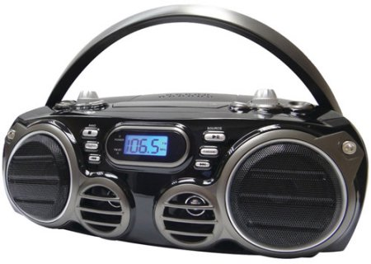
Movie Time!
In Season 9 Episode 7 “The Slicer” of the hit 90s TV show Seinfeld, George discovers that, years prior, he had a heated argument with his new boss, Mr. Kruger. This argument ended in George throwing Mr. Kruger’s boombox into the ocean. How did George make this discovery?
https://www.youtube.com/watch?v=pSB3HdmLcY4

Slide 50
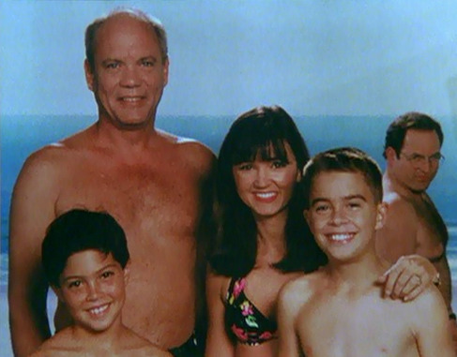

Slide 51
Seam Carving
Method for image resizing that doesn’t scale/crop the image

Slide 52
Seam Carving
Method for image resizing that doesn’t scale/crop the image

Slide 53
Seam Carving
Method for image resizing that doesn’t scale/crop the image
Cropped
Scaled
Carved

Slide 54
Cropping
Removes a “block” of pixels
Cropped

Slide 55
Scaling
Removes “stripes” of pixels
Scaled

Slide 56
Seam Carving
Removes “least energy seam” of pixels from bottom to top
https://www.aryan.app/seam-carving/ (also see Wikipedia page)
http://rsizr.com/ - old, uses Flash ☹
Carved

Slide 57
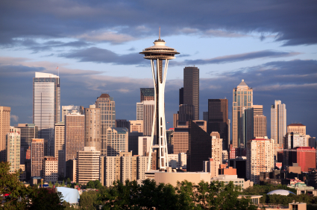
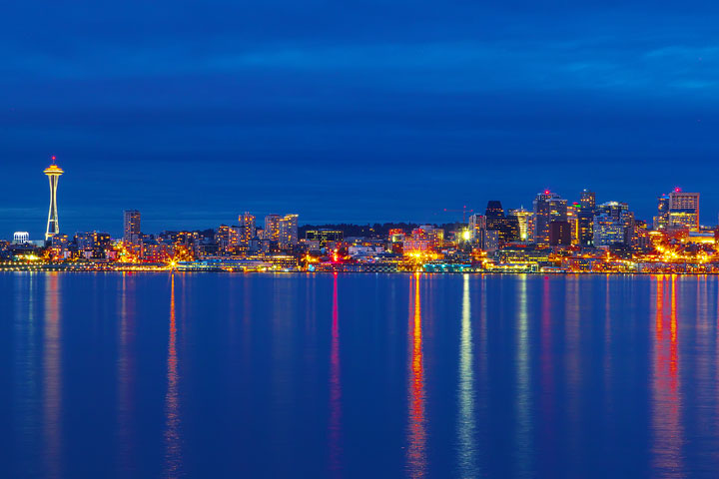
Seattle Skyline

Slide 58
Energy of a Seam
Sum of the energies of each pixel
$e\left(p\right)=$ energy of pixel $p$
Many choices
E.g.: change of gradient (how much the color of this pixel differs from its neighbors)
Particular choice doesn’t matter, we use it as a “black box”

Slide 59
Identify Recursive Structure
Let $S\left(i,j\right)=$least energy seam from the bottom of the image up to pixel $p_{i,j}$
$$p_{i,j}$$

Slide 60
Finding the Least Energy Seam
Want the least energy seam going from bottom to top, so delete:
$$\underset{k=1}{\overset{m}{min}}\left(S(n,k)\right)$$
$$p_{n,k}$$
$$n$$
$$m$$

Slide 61
Computing $S(n,k)$
Assume we know the least energy seams for all of row $n−1$
(i.e. we know $S(n−1,ℓ)$ for all $ℓ$)
$$p_{n,k}$$
Known through $n−1$
$$m$$

Slide 62
Computing $S(n,k)$
Assume we know the least energy seams for all of row $n−1$ (i.e. we know $S(n−1,ℓ)$ for all $ℓ$)
$$p_{n,k}$$
S(n,k)
S(n-1,k-1)
S(n-1,k)
S(n-1,k+1)

Slide 63
Computing $S(n,k)$
Assume we know the least energy seams for all of row $n−1$ (i.e. we know $S(n−1,ℓ)$ for all $ℓ$)
$$S\left(n−1,k−1\right)+e(p_{n,k})$$
$$S\left(n,k\right)=min$$
$$p_{n,k}$$
$$S\left(n−1,k\right)+e(p_{n,k})$$
S(n,k)
$$S\left(n−1,k+1\right)+e(p_{n,k})$$
S(n-1,k-1)
S(n-1,k)
S(n-1,k+1)

Slide 64
Seam Carving
Details left to you! Unit C Programming assignment
Note: Python or Java implementations only this time

Slide 65
Repeated Seam Removal
Only need to update pixels dependent on the removed seam
$2n$ pixels change
$Θ(2n)$ time to update pixels
$Θ(n+m)$ time to find min+backtrack
$$n$$
$$m$$

