Slide 1
CS4102 Algorithms Fall 2021 – Floryan and Horton
Module 10

Slide 2
Roadmap: Where We’re Going and Why
Reductions between problems
Why? Can be a practical way of solving a new problem
Also: A proof about one problem’s complexity can be applied to another
Formal definition of a reduction
Examples
Bipartite graphs, matching
Vertex cover and independent set

Slide 3
Using One Solution to Solve Something Else
Sometimes we can solve a “new” problem using a solution to another problem
We need to “re-cast” the “new” problem as an instance of the other problem
We may need to relate how the answer found for the other problem gives the answer for the “new” problem
Some examples coming in this lecture:
We’ll see how to solve edge-disjoint path problem. Use that to solve vertex-disjoint path problem.
We know how to find max network flow. Use that to solve bi-partite matching.

Slide 4
Edge-Disjoint Paths
Given a graph $G=(V,E)$, a start node $u$ and a destination node $v$, give the maximum number of paths from $u$ to $v$ which share no edges
g
Note this is an optimization problem.
$$u$$
h
f
$$v$$
e
b
c
a

Slide 5
Edge-Disjoint Paths
Given a graph $G=(V,E)$, a start node $u$ and a destination node $v$, give the maximum number of paths from $u$ to $v$ which share no edges
Set of edge-disjoint paths of size 3
(the red, blue, magenta paths)
$$u$$
g
Is this the max number?
h
f
$$v$$
e
b
c
a

Slide 6
Edge-Disjoint Paths
Given a graph $G=(V,E)$, a start node $u$ and a destination node $v$, give the maximum number of paths from $u$ to $v$ which share no edges
g
Set of edge-disjoint paths of size 4
$$u$$
Is this the max number?
h
f
$$v$$
e
b
c
a

Slide 7
Edge-Disjoint Paths Algorithm
Use a problem we know how to solve, max network flow, to solve this!
Make $u$ and $v$ the source and sink, give each edge capacity $1$, find the max flow.
1/1
$$s$$
g
Set of edge-disjoint paths of size 4
1/1
0/1
1/1
Max flow = 4
h
1/1
1/1
1/1
f
1/1
0/1
Why does this work? We need to be able to make a valid argument that it always does.
1/1
$$t$$
e
b
0/1
1/1
1/1
c
0/1
a
0/1

Slide 8
What’s the situation?
Given an input I₁ for the max network flow problem (graph G with edge capacities), we can find the max flow for that input
Given an input I₂ for edge-disjoint path problem, we can:
Convert that input I₂ to make a valid input I₁ for network flow problem, by using same graph G but adding capacity=1 for each edge
Solve max network flow problem for I₁ and get result R₁
Use R₁ to give the solution R₂ for edge-disjoint path for input I₂
In this case, |f| = the number of paths
Next, let’s solve another problem using our new edge-disjoint path solution

Slide 9
Vertex-Disjoint Paths
Given a graph $G=(V,E)$, a start node $u$ and a destination node $v$, give the maximum number of paths from $u$ to $v$ which share no vertices
$$u$$
g
h
f
$$v$$
e
b
c
a

Slide 10
Vertex-Disjoint Paths
Given a graph $G=(V,E)$, a start node $u$ and a destination node $v$, give the maximum number of paths from $u$ to $v$ which share no vertices
This shows 3 edge-disjoint paths. Note these aren’t vertex-disjoint paths!
$$u$$
g
h
f
$$v$$
e
b
c
a

Slide 11
Vertex-Disjoint Paths Algorithm
Idea: Convert an instance of the vertex-disjoint paths problem into an instance of edge-disjoint paths
Make two copies of each node, one connected to incoming edges, the other to outgoing edges
Compute Edge-Disjoint Paths on new graph
$$u$$
g
Restricts to 1 edge
g in
g out
h
f
Why does this work? We need to be able to make a valid argument that it always does.
$$v$$
e
b
c
a

Slide 12
What’s the situation now?
Given an input I₁ for the max network flow problem (graph G with edge capacities), we can find max flow for that input
Given an input I₂ for edge-disjoint path problem, we can:
Convert that input I₂ to make a valid input I₁ for network flow problem, and solve that to find number of edge-disjoint paths
Given an input I₃ for vertex-disjoint path problem, we can:
Convert that input I₃ to make a valid input I₂ for edge-disjoint path problem
See above! Convert I₂ to I₁ and solve max network flow problem
This chain of “problem conversions” finds lets us solve vertex-disjoint path problem
Time complexity? Cost of solving max network flow plus two conversions

Slide 13
Reductions
(We’re about to get interested in problems that seem to require exponential time…)

Slide 14
Max-flow vs. Edge-disjoint paths
These two problems are “related”
Here we’re saying: if you can solve Max-flow, you can solve Edge-disjoint path
Alternatively, we can say that one problem reduces to the other
The problem of finding Edge-disjoint paths reduces to the problem of finding max-flow
Maybe this reduction requires some work to “convert”
Could be nothing or minimal
For these problems, the cost of the conversion is hopefully small (more on this in a moment).

Slide 15
Reduction
A reduction is a transformation of one problem into another problem
Edge-disjoint paths is reducible to max-flow because we can use max-flow to solve it
Formally, problem A is reducible to problem B if we can use a solution to B to solve A
We’re particularly interested in reductions that happen fast!
Meaning the work to do the conversion is fast (how fast?)
If A is polynomial-time reducible to B, we denote this as: A ≤_{p} B
If the conversion takes linear time, we might say $A≤_{n}B$

Slide 16
In General: A Reduction
A problem we don’t know how to solve
Reduction
A problem we do know how to solve
$$A$$
Map Instances of problem $A$to Instances of $B$
$$B$$
Using any Algorithm for $B$
Map Solutions of problem $B$to Solutions of $A$
Solution for $A$
Solution for $B$
$$RA$$
$$RB$$

Slide 17
In General: Reduction
Problem we don’t know how to solve
Reduction
Problem we do know how to solve
$$A$$
Map Instances of problem $A$to Instances of $B$
$$B$$
Using any Algorithm for $B$
Map Solutions of problem $B$to Solutions of $A$
For now: we are NOT focusing on an algorithm to solve one of these, just on the reduction!
Solution for $A$
Solution for $B$
$$RA$$
$$RB$$

Slide 18
Total Runtime
The total runtime to solve A is:
Convert(A->B): Time it takes to convert problem A into problem B
Execute(B): Time it takes to execute algorithm to solve B
Solve(B->A): Time to convert solution of B back to solution of A
Total Runtime: Convert(A->B) + Execute(B) + Solve(B->A)
Do you see why we want convert() and solve() to be FAST. We want the slowest part to be the actual algorithm that solves B if possible.

Slide 19
Relative Hard-ness
Total Runtime: Convert(A->B) + Execute(B) + Solve(B->A)
Generally, we want execute() to be the slowest term, we then can say $A≤_{α}B$ where alpha is the runtime of convert() and solve()
If Execute() IS the slowest part, then what does that mean about the relative difficulty of solving A versus B??
It means that B is as hard or harder than A. Why?
Because B provides an algorithm that solves A, so if algorithm to solve B gets faster, so does the algorithm that solves A.

Slide 20
Max-flow vs. min-cut
These two problems are “equivalent”
Remember? max-flow min-cut theorem
Here we’re saying: if you can solve one, you can solve the other
Alternatively, we can say that one problem reduces to the other
The problem of finding min-cut reduces to the problem of finding max-flow
Maybe this reduction requires some work to “convert”
Could be nothing or minimal
For these problems, the cost of the conversion is polynomial

Slide 21
Bipartite Matching
Another example of a reduction

Slide 22
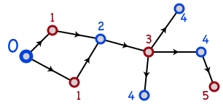
Bipartite Graphs
A graph is bipartite if node-set V can be split into sets X and Y such that every edge has one end in X and one end in Y
X and Y could be colored red and blue
Or Boolean true/false
How to determine if G is bipartite?
The numbers and arrows on edges may give you a clue….
BFS or DFS, and label nodes by levels in tree. Non-tree edge to node with same label means NOT bipartite.

Slide 23
Notes and assumptions
We assume the graph is connected
Otherwise we will only look at each connected component individually
A triangle cannot be bipartite
In fact, any graph with an odd length cycle cannot be bipartite

Slide 24
Bipartite Determination Algorithm
Pick a starting vertex, color it red
Color all adjacent nodes blue
And all nodes adjacent to that red
Etc.
If you ever try coloring a red-node blue, or a blue-node red, then the graph is not bipartite
Does this algorithm sound familiar?

Slide 25
Maximum Bipartite Matching
Dog Lovers
Adoptable Dogs

Slide 26
Maximum Bipartite Matching
Dog Lovers
Adoptable Dogs
Is this the best possible? The largest possible set of edges?

Slide 27
Maximum Bipartite Matching
Dog Lovers
Adoptable Dogs
Better! In fact, the maximum possible! How can we tell?
A perfect bipartite match:
Equal-sized left and right subsets, and all nodes have a matching edge

Slide 28
Maximum Bipartite Matching
Given a graph $G=\left(L,R,E\right)$
a set of left nodes, right nodes, and edges between left and right
Find the largest set of edges $M⊆E$ such that each node $u∈L$ or $v∈R$ is incident to at most one edge.

Slide 29
Maximum Bipartite Matching Using Max Flow
Make $G=(L,R,E)$ a flow network $G^{′}=(V^{′},E^{′})$ by:
Adding in a source and sink to the set of nodes:
$V^{′}=L∪R∪\{s,t\}$
Adding an edge from source to $L$ and from $R$ to sink:
$E^{′}=E∪\left\{u∈L \right| \left(s,u\right)\}∪\left\{v∈R \right| \left(v,t\right)\}$
Make each edge capacity $1$:
$∀e∈E^{′}, c\left(e\right)=1$
1
1
1
1
1
1
$$s$$
1
1
1
1
$$t$$
1
1
1
1
1
1
1

Slide 30
Maximum Bipartite Matching Using Max Flow
Make $G$ into $G′$
Compute Max Flow on $G′$
Return $M$ as all “middle” edges with flow 1
$$Θ(L+R)$$
$$Θ(E⋅V)$$
$$\left|f\right|≤L$$
$$Θ(L+R)$$
0/1
$$Overall:Θ(E⋅V)$$
1/1
0/1
1/1
1/1
1/1
$$s$$
1/1
0/1
1/1
0/1
$$t$$
1/1
1/1
1/1
1/1
1/1
1/1
0/1

Slide 31
Why does this work?
Each node on the left can be in at most one matching
This is enforced by the edge of capacity one leading into it
Likewise for each node on the right
The bottleneck will be how it flows across the bipartite “barrier”

Slide 32
Reduction details
We have transformed (in polynomial time) a bipartite matching problem into a maximal flow problem
Specifically, bipartite-matching ≤_{p} max-flow
Because we can transform bipartite matching to max-flow in polynomial time
But is it the case that max-flow ≤_{p} bipartite-matching?
Not so much: a solution to bipartite matching does not help us with a non-bipartite graph

Slide 33
Running time
Max flow runs in O(E*f)
But the max flow is (at most) V/2 (where V $=L∪R$)
If every node in the graph has flow through it, then there are V/2 units of flow moving through the graph
So the running time is equivalent to O(E*V)

Slide 34
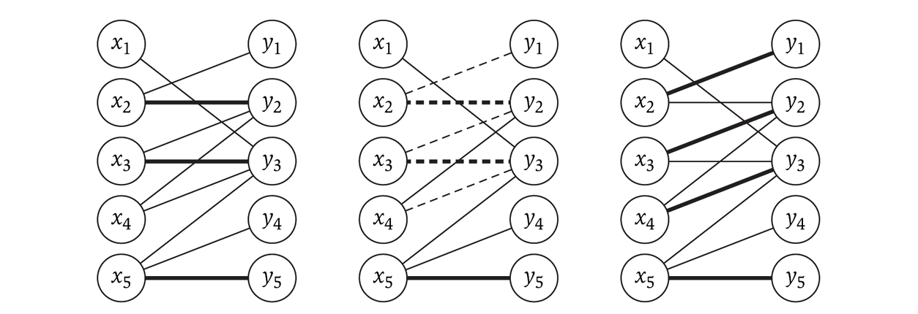
Imperfect bipartite matchings
These exist, and the algorithm may produce them, depending on the graph
The following shows an augmenting path (in the middle) used to achieve the maximal flow on the right

Slide 35
More Reductions Max-Flow “Variations”

Slide 36
Finding a Circulation
Real world applications don’t have just one source and sink
Instead there are multiple ones: power production / consumption, etc.
We designate a set S to be all the nodes that are sources
We can also view them has having negative demand
Likewise, we designate a set T to be all the nodes that are sinks
They have positive demand
Networks with multiple sources and sinks (modeled using demand) are called circulation networks

Slide 37
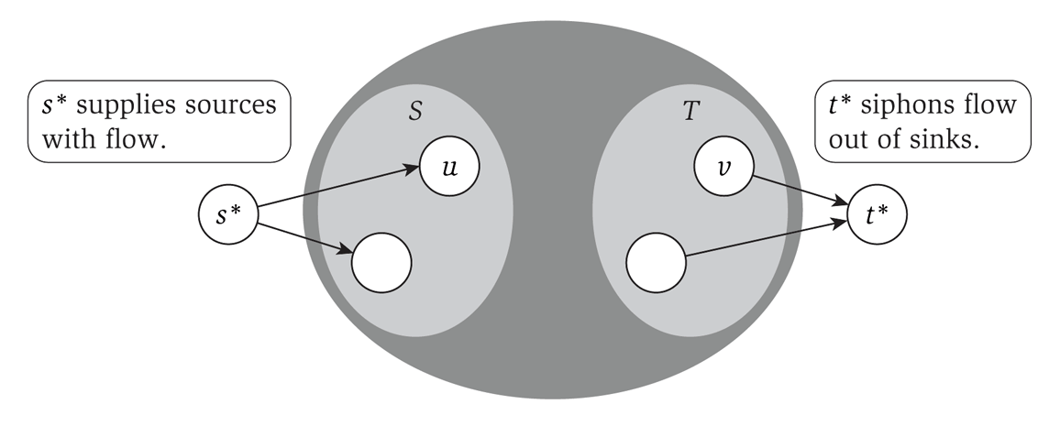
Reduction to max-flow
With a few modifications, we can make this a max-flow problem:
Create a ‘super source’ s* with edges to each node in S
The capacity of that edge is the size of the source of the node in S
Likewise with the set T

Slide 38
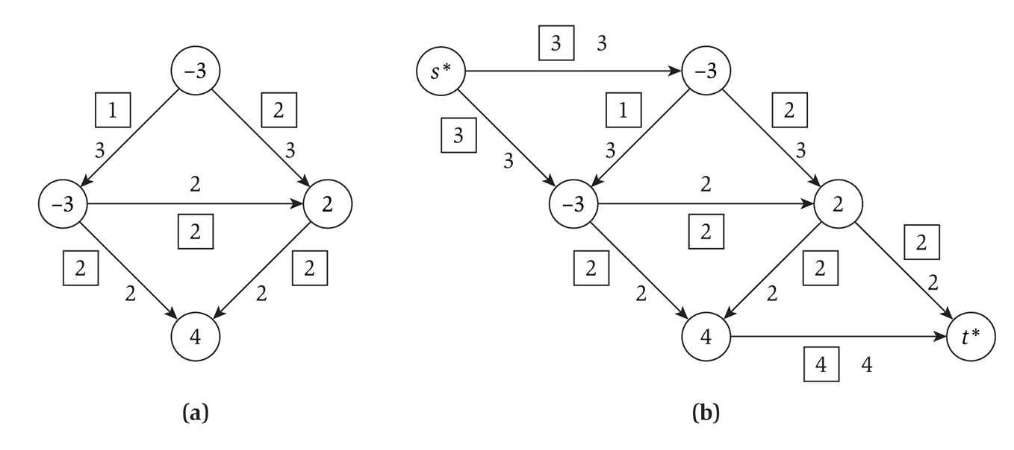
Conversion example
Converting a graph with multiple sources and sinks to a single-source-single-sink max-flow problem:

Slide 39
Circulation notes
A circulation problem is aiming for feasibility, not max flow
But we use max flow to solve it
We set each edge from the super-source to each individual source to be the absolute value as the individual source’s demand
Max-flow is then run
If the total amount leaving the single-source is the SAME as the capacity of each outgoing edge, then the circulation is feasible

Slide 40
Edge lower bounds
So far, we have considered only the capacity of an edge: the upper bound on the flow
We also want to consider a lower bound on the flow on an edge
i.e. forcing a certain amount of flow through an edge
We will reduce this to a circulation problem
Which can then be reduced to a max-flow problem

Slide 41
Handling lower bounds
A lower bound forces flow across an edge
Which increases demand at the start of the edge (to compensate for the flow across the edge)
And decreases demand at the terminus of the edge (as some flow is fulfilling the demand)

Slide 42
Solving a flow with lower bounds
Given a circulation network G, construct a new graph G’ such that for each edge e from u to v with a lower bound l_{e}:
We decrease the capacity on that edge by l_{e}
As that is the flow that is moving through the edge
We increase the demand at u by l_{e}
We decrease the demand at v by l_{e}
Then solve G’ as a circulation problem
i.e. add a super-sink and super-terminus, and solve as a max-flow problem

Slide 43
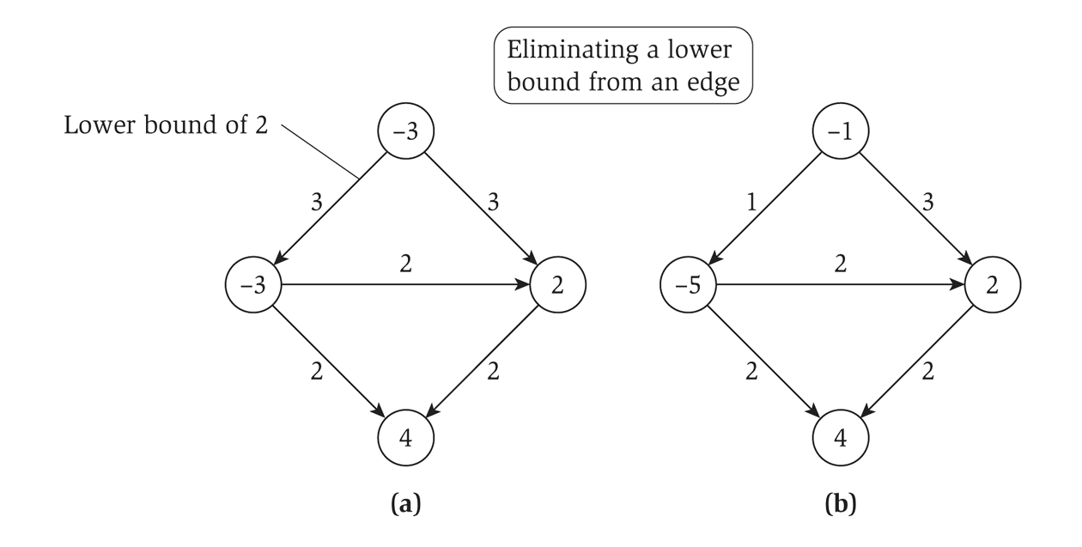
Eliminating a lower bound
Diagrammatically…

Slide 44
Example: Airplane Problem

Slide 45
From an Old HW Problem
Suppose you are given a list of potential flights F = {f1, f2, ..., fn} that your airline wishes to serve. You can think of these as flight objects. Each flight has several fields including starting airport, ending airport, departure time, and arrival time. Develop an algorithm that, given flights F and a value k, determines whether it is possible to serve all of the flights in F with at most k planes. You must adhere to the following additional constraints:

Slide 46
From an Old HW Problem
Plane maintenance takes m minutes. No plane can depart less than m minutes after arriving at an airport.
A plane can fly between any two airports. For example, if you have two flights you want to serve in F (LA to BOS, NYC to DC) then we might choose to fly a plane from LA to BOS, then fly from BOS to NYC (even though that leg isn’t in F ) so that this plane can then serve NYC to DC.
You are given another parameter l. If you are splicing in an extra flight (see item above) then you must have at least m time for maintenance and l time for the other flight (yes, this is a pretty simple and unrealistic assumption, but is fine for our purposes).
A plane does not need to end its day at the same airport from which it started. You can assume that all flights are during the day (between 6am and 12 midnight), and that there is an overnight flight at the end of the schedule back to the first departing airport before the next day begins.

Slide 47
From an Old HW Problem
Let’s discuss how we can model this problem as a circulation network!
We’ll draw an example while working it out -->

Slide 48
From an Old HW Problem
First, think of the flights? What is the capacity of the edges? Lower bounds??

Slide 49
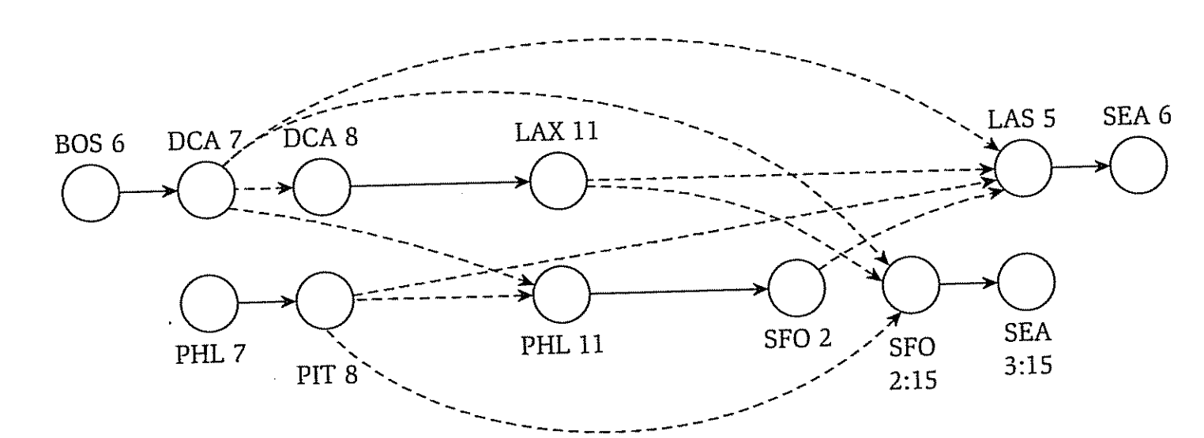
From an Old HW Problem
Extra flights to model planes being re-used. What is capacity? Lower-bounds?

Slide 50
From an Old HW Problem
Now…let’s add source and sink node and related edges

Slide 51
Conclusion
We already have an algorithm that solves:
Circulation networks
Demands on nodes output / input
Lower-bounds on edge flow
So the “work” here is not in the algorithm, but in modeling the problem using the structure for which we already have an algorithm!!

Slide 52
Summary

Slide 53
What did we learn?
Max-flow / min-cut
The problems, relationship between them, etc.
Ford-Fulkerson algorithm and related proofs that this approach is optimal
Bi-partite matching
First example of a reduction. Use the algorithm from one problem to solve another problem.
More reductions
Solving variations of max-flow by converting the problem into an instance of “normal” max-flow.

